Slide 1
2021 FALL PRODUCT SALE
PA Dutch Council
Notes:
Joe’s Welcome
We will cover the majority of the guidebook in this presentation.

Slide 2
THE PA DUTCH COUNCIL TEAM
Joe Flaim
Council Kernel
Matt Adams Staff Advisor
Robin Kotzmoyer
Council Support
Northern District
Nicole Welch – DE
Myrna Walker – DK
April Sherk
Veronica Swope
Southern District
Sheila Fasig – DE
Roger Harvey – DK
Erin Brossman
Lisa Lyons
Notes:
Joe -

Slide 3
OUR 2021 PARTNERS
KELLER MARKETING
Notes:
Joe –
In 1983, Rural Route 1 Popcorn was approached by the U.S. Grant District Boy Scouts of America to produce pails of popcorn to be used as a fundraiser. Pecatonica River Popcorn was established as an exclusive brand solely for Scouting use.
Pecatonica River’s niche has been to provide an individualized program for each Council, capitalizing on their strengths and assets.
Everything from specific container designs, to unique products and specialized forms create a program unique to each Council.
In 1986, with one small batch roaster and 3 employees cooking peanuts, Marion Smith and his son Craig opened the doors to Whitley's Peanut Factory, which still stands as a retail store off Route 17 in Gloucester, VA.
Thirty-three years and millions of peanuts later, Whitley's Peanut Factory has become a local staple for "Home-Cooked" Virginia peanuts and peanut confections.
Their products are handmade. Yes, they cook their peanuts by hand and hand dip all of their peanut clusters one at a time with care and attention.
Brad Siefke of Keller Marketing, has been with Keller Marketing 27 years – involved with the Scouting Division with the prize program.
Keller has it’s own warehouse and it’s own pick and pack staff.
Brad has worked with Pecatonica River for 20 years. They have a good working relationship.

Slide 4
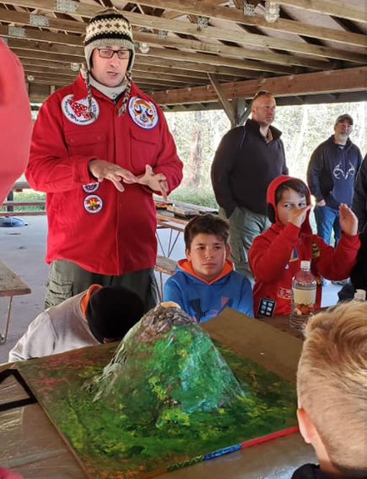
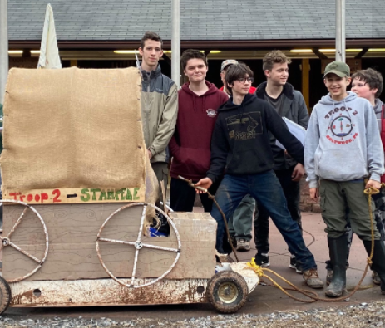
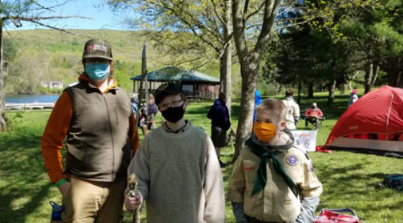
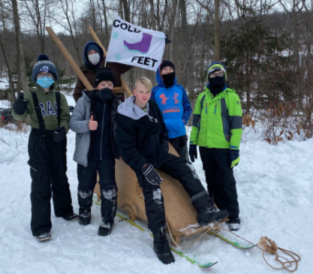
WHAT DID YOUR UNIT DO?
Notes:
Joe-
Discuss how units have used their fall product profit.

Slide 5
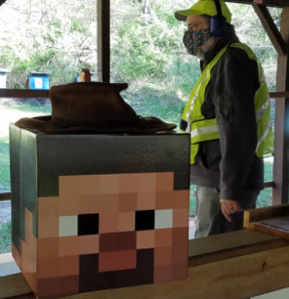
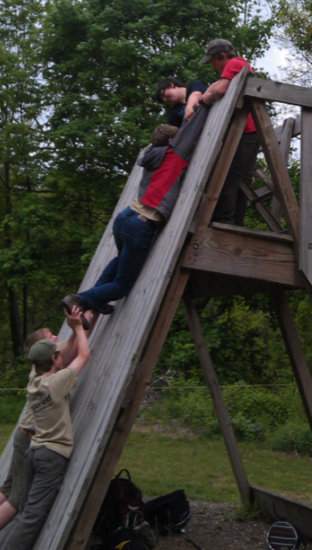
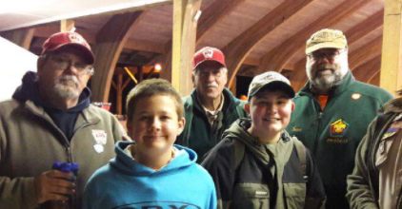
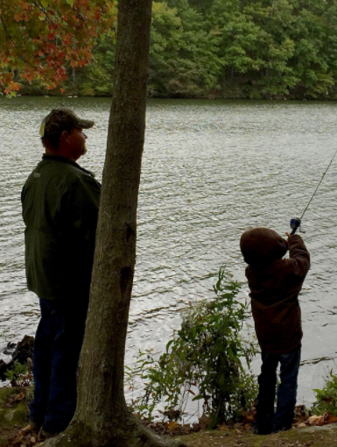
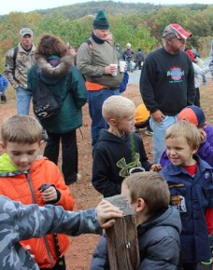
SCOUTING IS POSSIBLE BECAUSE OF SCOUTERS LIKE YOU!
Notes:
Joe –
Thank you for being here this evening. Without volunteers like you, we would not have quality Scouting programs. Because of your support, Scouts have had numerous opportunities to explore the Scouting adventure.

Slide 6
Top Selling Units
Conestoga River District
X Pack 19 - $ 14,280.00
X Pack 82 - $ 6,940.00
X Pack 146 - $ 5,515.00
DREAM BIG!
Notes:
Joe –
The Fall Product Committee would like to recognize last year’s success stories!

Slide 7
Top Selling Units
Conestoga River District
X Pack 19 - $ 14,280.00
X Pack 82 - $ 6,940.00
X Pack 146 - $ 5,515.00
DREAM BIG!
Top Selling Units
Harvest District
X Troop 267 - $ 10,680.00
X Pack 184 - $ 9,610.00
X Pack 37 - $ 7,185.00
Notes:
Joe-

Slide 8
Top Selling Units
Conestoga River District
X Pack 19 - $ 14,280.00
X Pack 82 - $ 6,940.00
X Pack 146 - $ 5,515.00
DREAM BIG!
Top Selling Units
Harvest District
X Troop 267 - $ 10,680.00
X Pack 184 - $ 9,610.00
X Pack 37 - $ 7,185.00
Top Selling Units
Horseshoe Trail District
X Pack 44 - $ 31,910.00
X Troop 456B - $ 9,595.00
X Troop 420 - $ 5,350.00
Notes:
Joe -

Slide 9
Top Selling Units
Conestoga River District
X Pack 19 - $ 14,280.00
X Pack 82 - $ 6,940.00
X Pack 146 - $ 5,515.00
DREAM BIG!
Top Selling Units
Harvest District
X Troop 267 - $ 10,680.00
X Pack 184 - $ 9,610.00
X Pack 37 - $ 7,185.00
Set your sales goals
Conduct a fun and exciting unit kick-off
Communicate with your Scout families
Use unit incentives
Participate in all methods of selling
Top Selling Units
Horseshoe Trail District
X Pack 44 - $ 31,910.00
X Troop 456B - $ 9,595.00
X Troop 420 - $ 5,350.00
Notes:
Joe –
Set your sales goals – setting a goal for the unit provides a target to achieve. Encourage each Scout to set a goal – when the goal is exceeded, the Scouts gains confidence.
Conduct a fun and exciting unit kickoff – Set the tone of the sale. An enthusiastic, positive kickoff will encourage your Scouts to reach their goals.
Communicate with your Scout families – Communication, communication, communication. And then more communication. Keep in touch with the families and the leaders. Inquire about their progress. Share successes!
Use unit incentives – even if your unit chooses to opt out of the incentive prize program, your unit can still provide it’s own incentive. What are some examples of incentives units have used in the past?
Participate in all methods of selling – using a multi-level approach to the sale strengthens your unit’s ability to have the best sale ever!

Slide 10
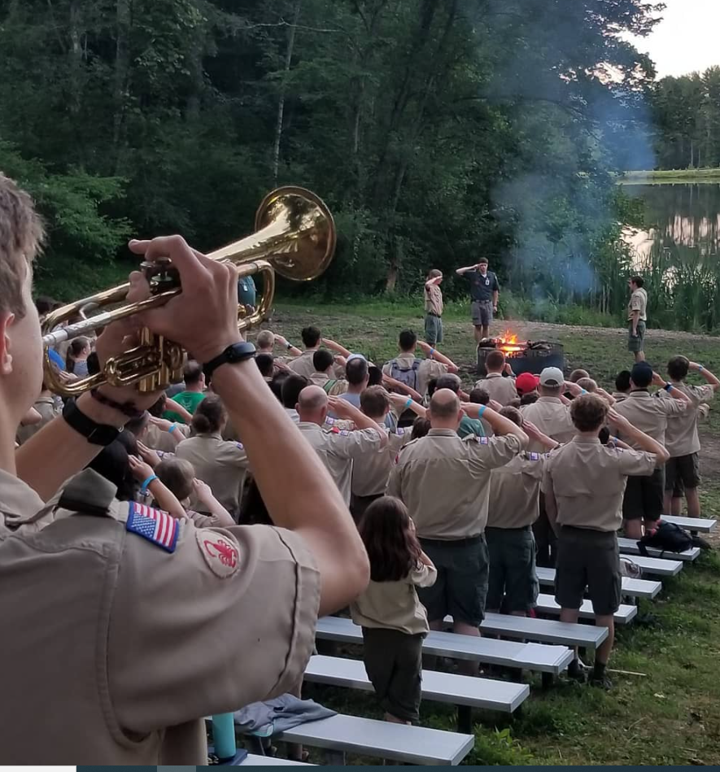
2020 OUTSTANDING
SALESMANSHIP AWARD
In Recognition of Outstanding Salesmanship in
Support of Scouting in the PA Dutch Council
Presented to
Landon Dippner – Pack 44 – $ 5575.00
Nathan Yang – Troop 420 – $ 3800.00
Carter Geesaman – Pack 44 – $ 3285.00
Notes:
Joe –
Encourage your Scouts to reach for the stars. Salesmanship is a learned skill that will be useful in many ways for many years.

Slide 11
YOU CAN DO IT TOO!
Notes:
Joe –
All we ask is that you do your best!

Slide 12
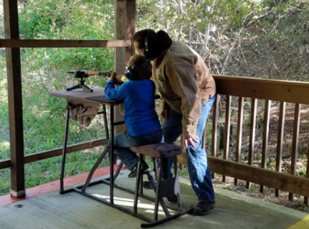
Tonight’s Agenda…
Product Updates
Methods of Selling
2021 Incentives & Commission
Pecatonica River System
Tips & Best Practices
Notes:
Joe -

Slide 13
2021 CALENDAR
Notes:
Matt –
Please note the key dates.
Our sale calendar was put together to allow us to work with New Birth of Freedom Council and Hawk Mountain Council for maximum efficiency.
August – Show & Sell order due Tuesday, the 3rd. The 24th, 25th, and 26th - Show & Sell orders will be delivered to the warehouses, sorted by volunteers and pick up times will be scheduled.
September – Two deadlines – the 3rd and the 17th - to order additional product for Show & Sell, Wagon Draggin’, Drive Throughs, etc. SUPER SATURDAY – encourage your Scouts to sell using all methods and then celebrate the success of your unit’s highest salesman.
October – 1st – one last time to order additional Show & Sell product. If your unit has no returns, visit the Council office by the 15th with your Show & Sell product payment. If you have any product to return – schedule a time on the 17th to make returns and pay for your Show & Sell product. The 19th is the deadline for Take Orders to be submitted.
November – 9th and 10th – Take Order Product will be delivered to the warehouses, sorted by volunteers and pick up times will be scheduled. Take Order payment is due to the Council office November 19th.

Slide 14
PATH TO ADVANCEMENT
Notes:
Matt-
We found that other Councils were promoting how the Fall Product sale can be used to earn advancements. If you have not already done so, introduce this concept to your Scouts to promote the advantages of participating and succeeding in the Fall Product sale.

Slide 15
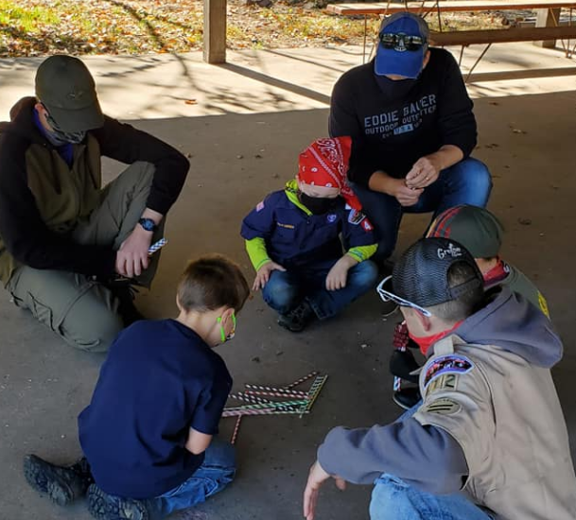
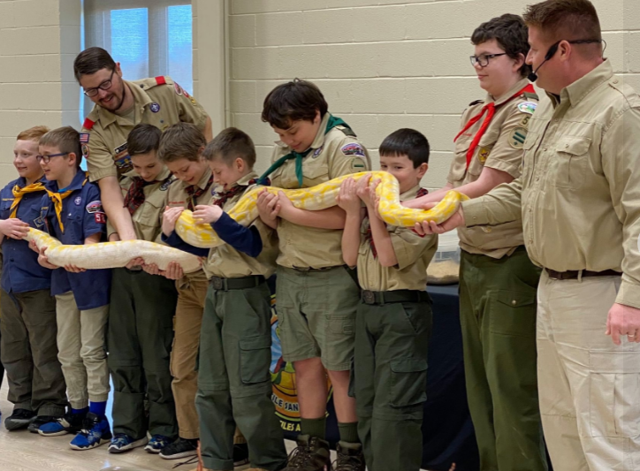
2021
PRODUCT
Notes:
Matt -

Slide 16
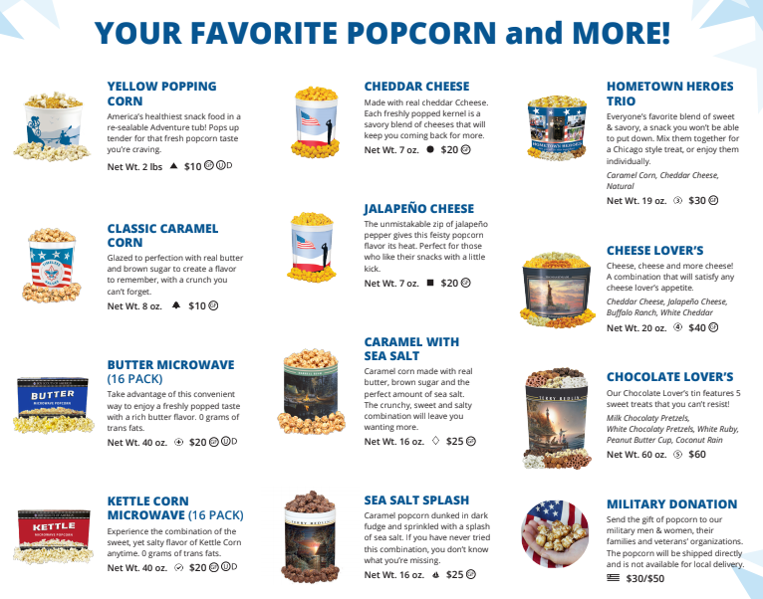
*Show & Sell
Notes:
Matt –
As you review the Pecatonica River Popcorn sales flyer, you will see much of the same product that we enjoyed in years past.
All popped corn product is packaged in a tub or a tin. The pricing is mostly the same as last years items.
Any of the products with a green arrow are available for Show & Sell. To learn what items are available online, refer to your PA Dutch Council 2021 Popcorn and Nut Sale Guidebook.
Tasting Kit Information!!!

Slide 17
NEW
NEW
*Show & Sell
Notes:
Matt –
Pecatonica River is offering two new flavors.
Hometown Heros Trio – a sweet and savory combination – Caramel Corn, Cheddar Cheese, and Natural.
Jalapeno Cheese – a feisty treat for those who enjoy a kick of flavor.
The online lineup is featured in the 2021 Fall Product Guidebook. Please familiarize your Scouts and families with the online product available should a customer ask about ordering online.

Slide 18
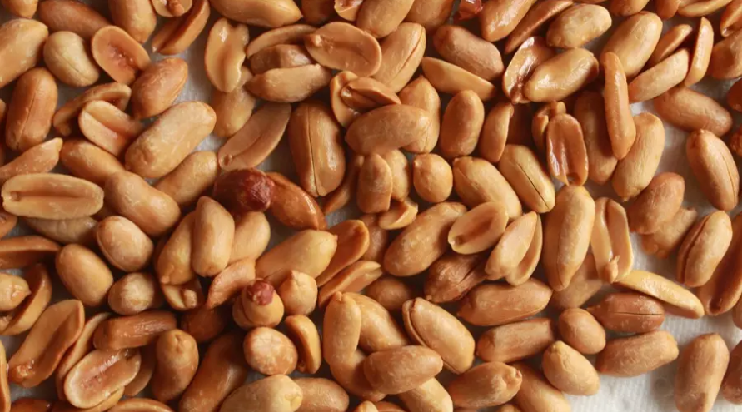
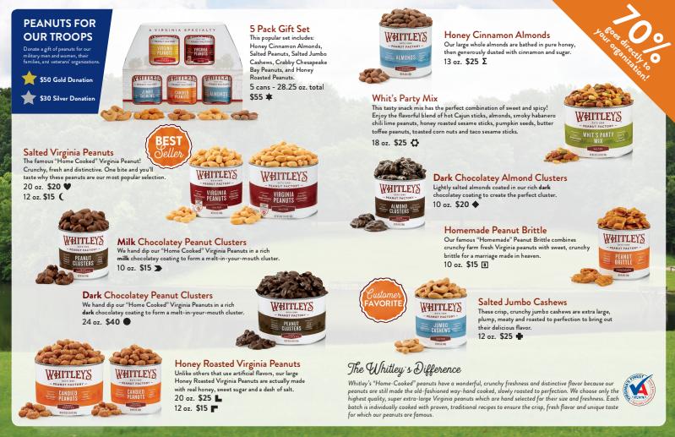
*Show & Sell
Notes:
Matt and Roger Sams –
Whitley’s product line has not changed much.
The two most noticeable changes:
The salted peanuts and the honey roasted peanuts are no longer referred to as Troop nuts.
The salted peanuts and the honey roasted peanuts are available in two sizes - a 12 ounce container and a 20 ounce container.
The items marked with a green arrow are available for Show & Sell. To learn what items are available online, refer to your PA Dutch Council 2021 Popcorn and Nut Sale Guidebook.

Slide 19
NEW
*Show & Sell
Notes:
Matt and Roger Sams –
Also new for Whitley’s Nuts this year – for those customers who cannot eat nut products, they can make a troop donation. They offer a $ 30.00 donation and a $ 50.00 donation.
The online lineup is featured in the 2021 Fall Product Guidebook. Please familiarize your Scouts and families with the online product available should a customer ask about ordering online.

Slide 20
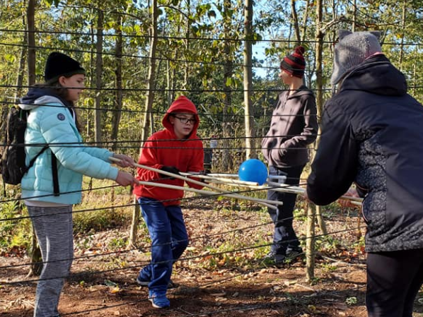
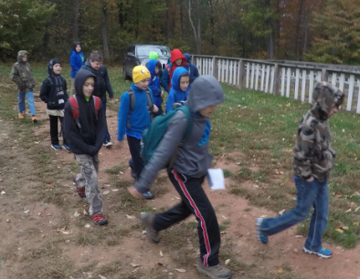
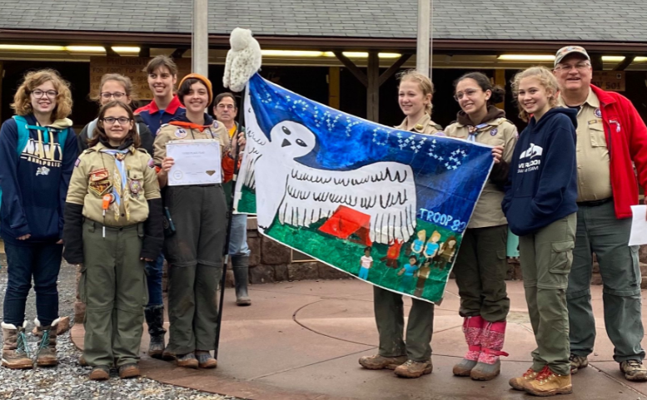
METHODS OF SELLING
Notes:
Roger H -

Slide 21
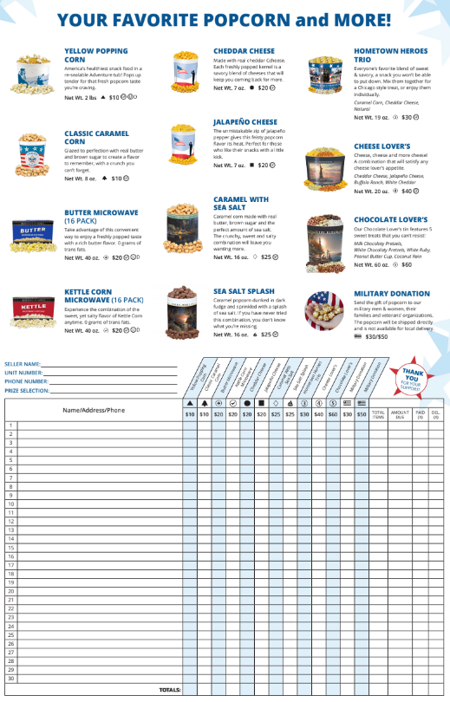
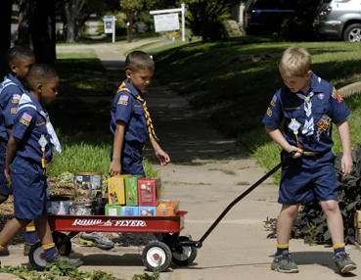
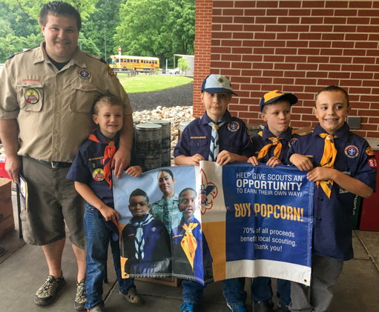
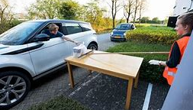
Methods
of Selling
Notes:
Roger H –
Units have multiple methods to sell popcorn and nuts.
Show & Sell – Standard storefront Show & Sell, Wagon Draggin’, Drive Through Sales. Your Show & Sell allotment is 80% of either your 2019 or 2020 sale – whichever was better.
If your dollar figure is low, you will have three opportunities to order more popcorn and nuts. More information about this will be coming later in the presentation.
Take Order
Online sales
Promote Super Saturday within your unit to boost your unit’s sales. On the calendar, we have designated September 18th as Super Saturday, but if this date does not work for your unit, pick another date.
You could also expand Super Saturday to a one week time frame. Whatever works best for your unit.

Slide 22
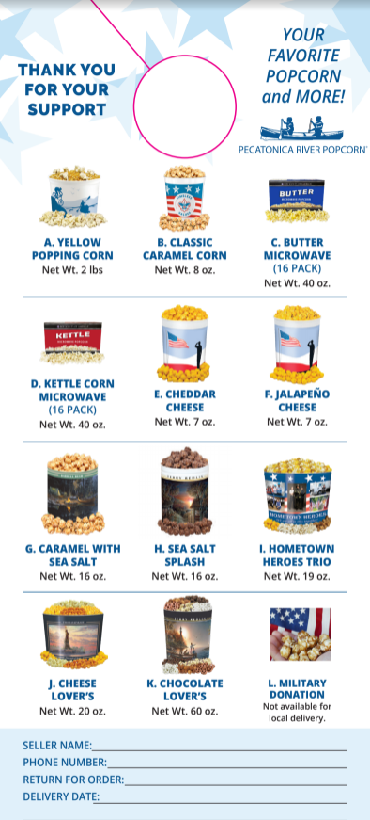
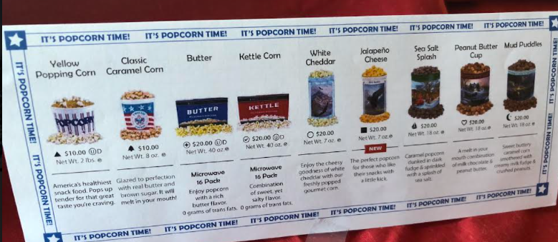
DOORHANGERS
Go to squareup.com/i/PRPOPCORN1 to receive free processing on up to $1,000 in credit card transactions for the first 180 days.
SUPER SATURDAY PRIZE!
TABLE TENTS – The Silent Seller
Notes:
Roger H –
Pecatonica River Popcorn and Whitley’s Nuts are providing you with several marketing tools to assist with “advertising” your sale.
Pecatonica River has provided printed door hangers, and table tents. They also are giving each unit a Super Saturday Prize and a tasting kit of items on the take order form.
Whitley’s Nuts had also supplied each unit with door hangers.
Your unit can make a choice of utilizing a credit card payment system and/or what system you will use. Pecatonica River will cover the processing fee for the first $ 1,000.00 in popcorn sales, but you must register as a new user at squareup.com/i/prpopcorn1 to take advantage of this offer. Please note that you are not required to use the Square tool. If you already use Venmo or PayPal or another merchant, feel free to continue to use that merchant.
Also, the PA Dutch Council does not endorse, support or promote the use of any specific credit card payment system.

Slide 23
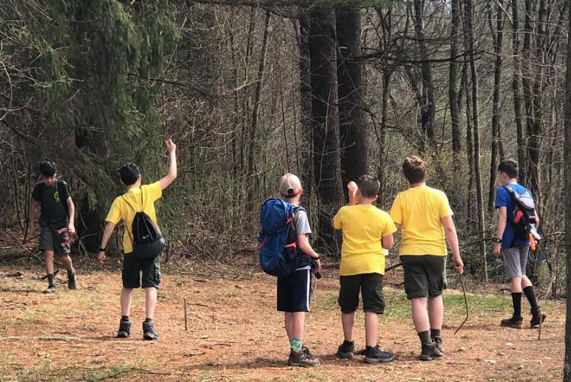
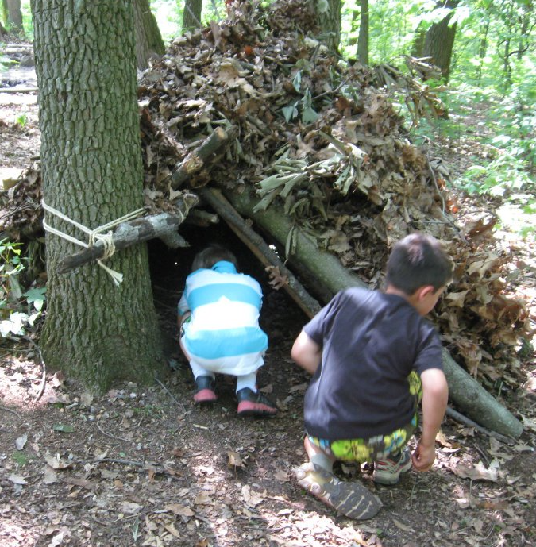
KERNEL TOOL KIT
GUIDEBOOK
PECATONICA RIVER
ORDER FORMS
Notes:
Roger H –
Now that we have gone over some basics, lets find out what you have in your tote.
PA Dutch Council 2021 Popcorn and Nut Sale Guidebook – filled with a lot of critical information.
Pecatonica River Take Order flyers – Pecatonica River mailed Take Order flyers to Scouts who were listed on your unit recharter.

Slide 24
KERNEL TOOL KIT
GUIDEBOOK
PECATONICA RIVER
ORDER FORMS
KELLER
PRIZE
SHEETS
WHITLEY’S
ORDER FORMS
Notes:
Roger H –
Whitley’s Nut Take Order forms. – Each of your Scouts will need one of these forms. They were not included in the mailing.
Keller Marketing Prize Incentive Sheet – Incentive prizes will be order through the Pecatonica River Popcorn System. If you search the internet, you will find a user system for Keller Marketing – do not use this stand alone system – all prize orders must be place through Pecatonica River.

Slide 25
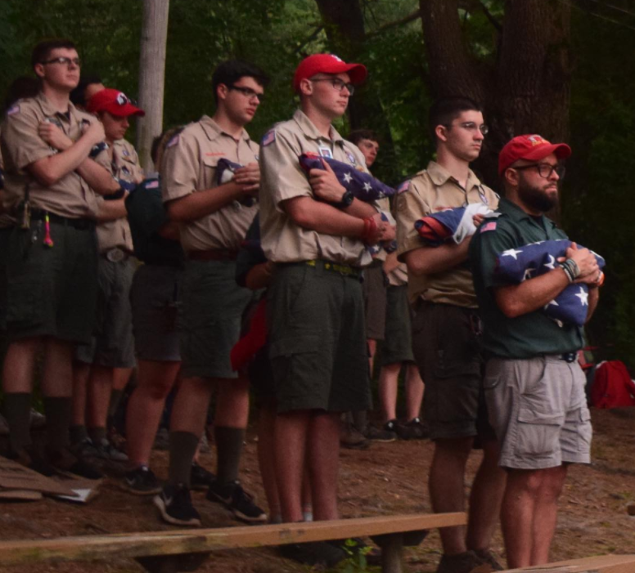
KERNEL TOOL KIT
TASTING KIT
SUPER SATURDAY PRIZE
Notes:
Roger H –
Popcorn Tasting Kit – filled with each flavor of your Pecatonica River order form. Share with your unit or use at Show & Sell booths to give customers a taste.
Super Saturday Prize – Pecatonica Rive supplied each unit with a Super Saturday prize. Most Scouts will want this prize.

Slide 26
KERNEL TOOL KIT
TASTING KIT
SUPER SATURDAY PRIZE
TABLE TENTS
DOOR HANGERS
Notes:
Roger H -
Table Tents – They are referred to as the “Silent Seller”. Set this on a desk or a counter, etc. to attract sales without asking.
Door Hangers – Both Pecatonica River and Whitley’s Nuts have provided printed door hangers for your Scouts to use. Please feel free to print copies to increase your number of door hangers.
Any questions about any of the items in your Kernel Tool Kit?

Slide 27
Notes:
Roger H - Video

Slide 28
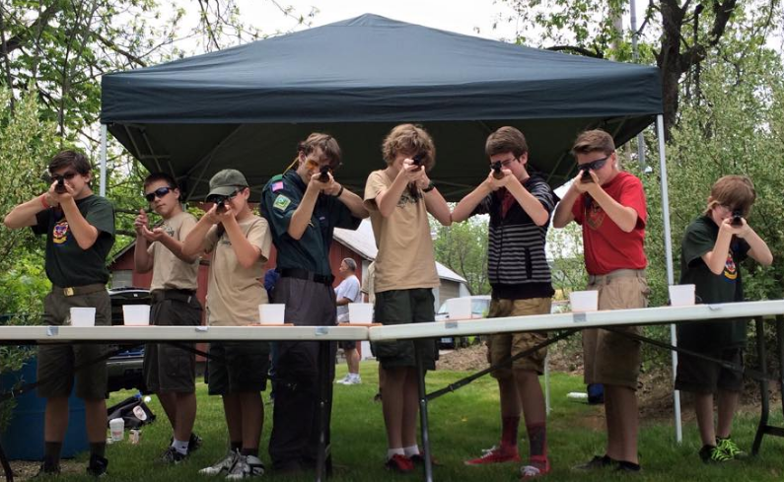
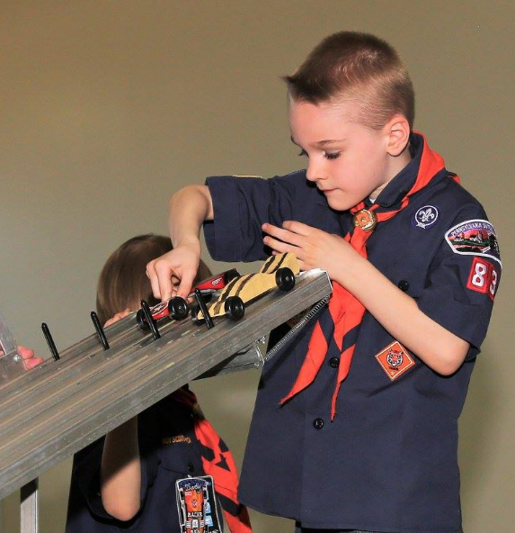
COMMUNICATION
Key to a Successful Sale
Publish Your Sales Dates
Have a Unit Kickoff
Have a Celebration
Notes:
April –
Communication, communication, communication. We can’t stress enough how important communication is to the success of your sale.
Key to a Successful Sale - The more information you send out to your families, the better prepared they will be. Keep in touch with your unit families and leaders. Give them updated information and reminders. Ask the Scouts how their sales are progressing. Show an interest in their performance. Recognize successes. A little praise can rejuvenate your Scout’s attitude. Stay positive!!
Publish Your Sales Dates – distribute a calendar to your families in multiple formats. Poster in the meeting place – Oral announcements – Paper handout – Emails – Website – other Social media. Put your sale date information in the hands of your Charter Organization. Don’t forget to include important dates on the Take Order flyers.
Have a unit kickoff – This can set the whole tone of the sale. Employ volunteer help to help with the kickoff. Make it fun. Make it informative. For some fun kickoff ideas, check out the links on the Fall Product Sale page on the Council website.
Wrap it all up with a fantastic celebration! Reward the Scouts and the families for their hard work and their support.

Slide 29
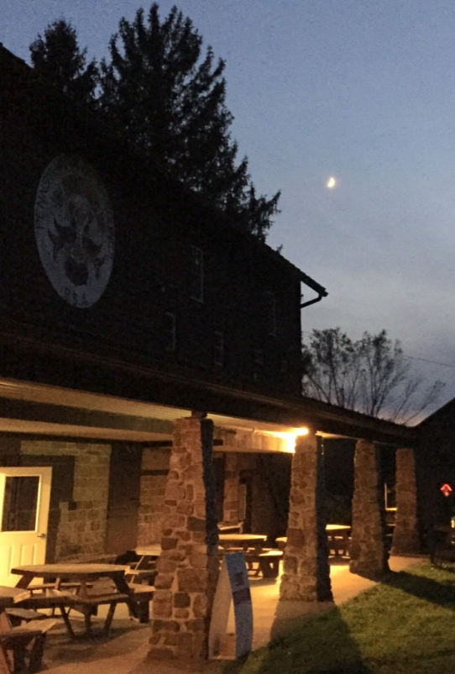
INCENTIVES AND COMMISSIONS
Notes:
April -

Slide 30
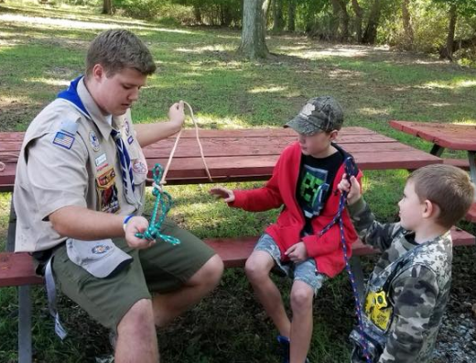
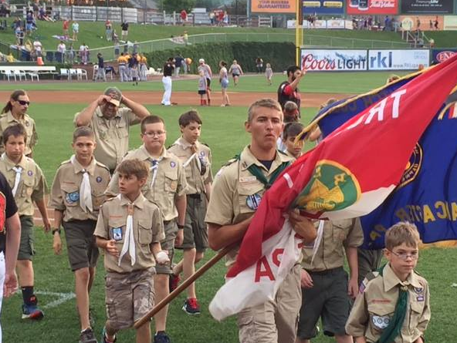
INCENTIVE PRIZE OPTION
31% Commission
Incentive Prizes by Sales Level
Winner’s Circle Sales Level
Military Pin
Top Salesman Pin
Online Sales Pin
NO PRIZE OPTION
34% Commission
Winner’s Circle Sales Level
ONLINE SALES
30% Commission
Notes:
April –
Incentive Prize Options and Commissions
Utilizing the Keller Marketing incentive prize system. 14 levels of prizes, pins for Military sales, Top Sales recognition and Online Sales, Winner’s Circle Level for the ambitious Scouts who sell more than $2,500.00 in POPCORN. The incentive prize levels are determined by a combination of popcorn and nut sales – Show & Sell + Take Order + Online Sales. Winner’s Circle Prizes are restricted to POPCORN sales – Show & Sell – Take Order – Online Sales.
With the incentive prize option, the unit receives 31% Commission on popcorn and nuts sales.
Choosing the no prize option. The unit receives 34% commission on popcorn and nut sales. The unit may choose to use the extra commission to develop a unit-based incentive program. Keep in mind that Scouts whose POPCORN sales exceed $2,500.00 are part of the Winner’s Circle and can choose a prize for each increment of $2,500.00 in POPCORN sales.
The 31% vs 34% commission structure is based on Show & Sell and Take Order sales. Any online sales produce a 30% commission. Online sales commission is not deducted from the product payments to the Council. Commissions from online sales will be awarded to the unit via check after the online sales have ceased and been calculated.

Slide 31
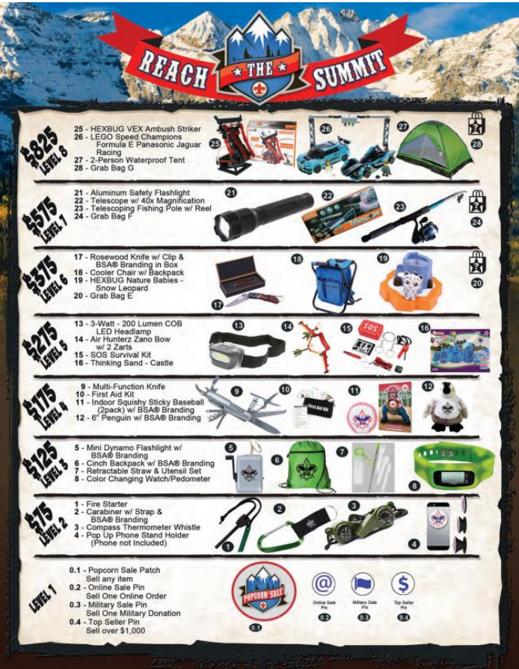
INCENTIVE PRIZE OPTION
Total Popcorn and Nut Sales
Show & Sell + Take Order + Online Sales
Order through Pecatonica River system
Notes:
April –
Maybe highlight some of the prizes available.
The Incentive Prize Option is typically attractive to Packs, but Troops may take advantage of this option as well. Again, remember that the incentive prize level is based on total sales of popcorn and nuts from all methods of sales.
Also make a note that these prizes must be ordered through the Pecatonica River Popcorn system.
If your unit has chosen to use the incentive prize option, be sure to communicate this to the Scouts and families. Remind them that the prize order is due with the Take Order flyer.

Slide 32
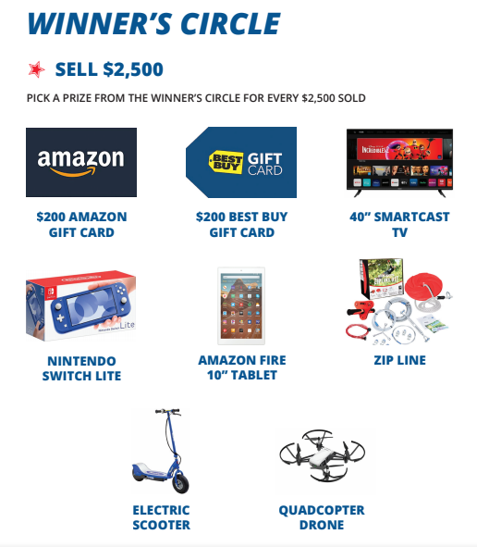
WINNER’S CIRCLE
Regardless of the prize option chosen by the Unit, any
Scout who sells more than
$ 2,500.00 in POPCORN will be able to choose a prize for every $ 2,500.00 sold.
WINNER’S CIRCLE
POPCORN SALES ONLY
Show & Sell + Take Order + Online sales. The Unit will need to attach proof of the Scout’s POPCORN sales under Winner’s Circle in the Pecatonica River System.
Notes:
April –
Point out the prizes available in the Winner’s Circle.
Winner’s Circle prizes are available to any Scout who sells more than $2,500.00 in POPCORN. Ordering Winner’s Circle Prizes is done through the Pecatonica River Popcorn system and support documentation must be submitted with the order. When completing the Winner’s Circle order information, the Zip Code, Pick Up name and Pick Up email should be either the Unit Representative or the parent/guardian of the qualifying Scout(s). Should the Scout choose the Amazon Gift Card or the Best Buy Gift Card, enter the ZIP Code, Pick Up name and Pick Up email of the Scout’s parent/guardian since the cards will be distributed via email.

Slide 33
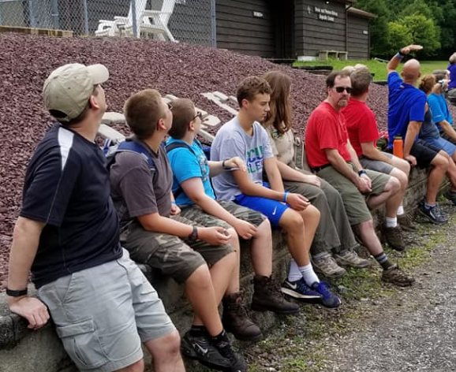
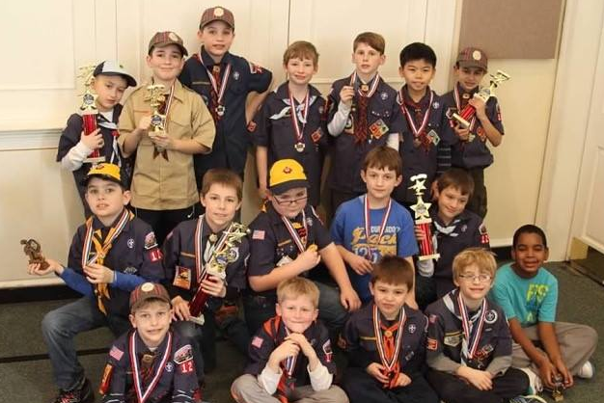
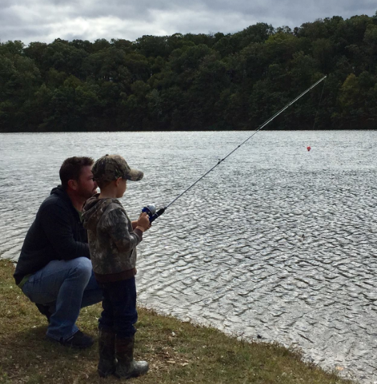
FIVE KEYS TO A SUCCESSFUL SALE
Sales Goal
Unit Kick-off
Communication
Incentives
Methods of Selling
Notes:
April –
Five Keys to a Successful Sale
All of this information has been discussed before, but our goal is for your unit to have the best sale ever!
Sales Goal – Sales goals are important. When achieved they teach responsibility and accountability.
Unit Kickoff – Set the mood of your sale. Be enthusiastic, positive, fun, and available for questions. Don’t forget to obtain volunteer help.
Communication – Clear away any stumbling blocks in your sale by communicating with your unit members every way you possibly can. Keep the sale in the forefront of everyone’s mind.
Incentives – Develop an incentive program for your unit. Whether it is the Keller Marketing Prize program, or you come up with your own program, you will increase your participation with some incentive. For some alternate incentive ideas, refer to the links on the PA Dutch Council Fall Product page.
Methods of Selling – The more people you ask, the more sales you have. The more methods of selling, the better your units total sales.

Slide 34
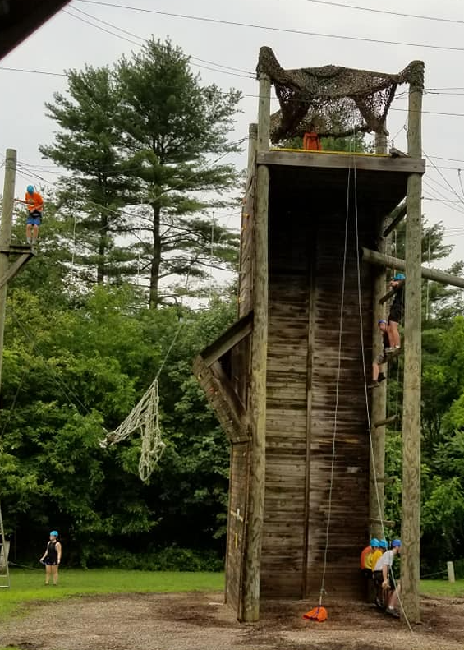
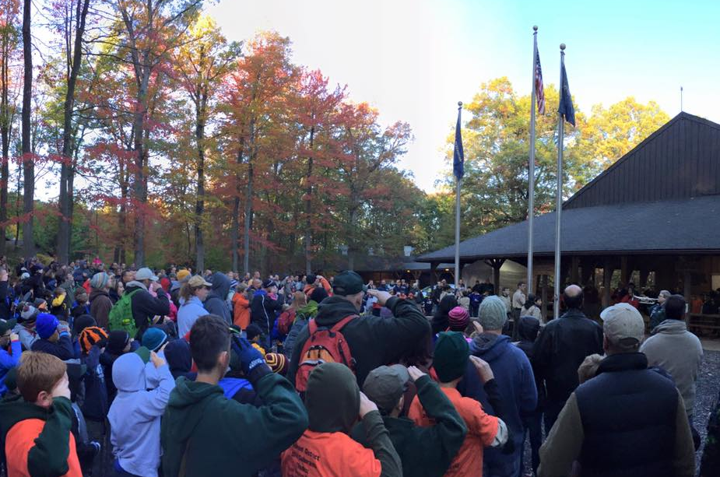
USING THE PECATONICA RIVER SYSTEM
Notes:
Veronica -

Slide 35
REGISTER
Notes:
Run video

Slide 37
SET UP SELLER ID
Notes:
Run video

Slide 39
ONLINE SCOUT REGISTRATION
Notes:
Run video

Slide 41
KERNEL TRACKER
Notes:
Run video
Veronica –
Those of you who were Kernels last year, will most likely find the Pecatonica River System to be fairly similar.
Should you have any questions about any of the functions of the Pecatonica River System, please reach out to your District Executive or your District Kernel. Keep in mind that we may need to do some research to answer your questions since certain functions of this system are new to us as well.

Slide 43
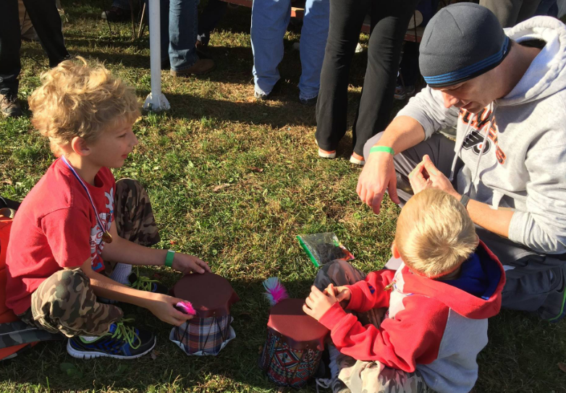
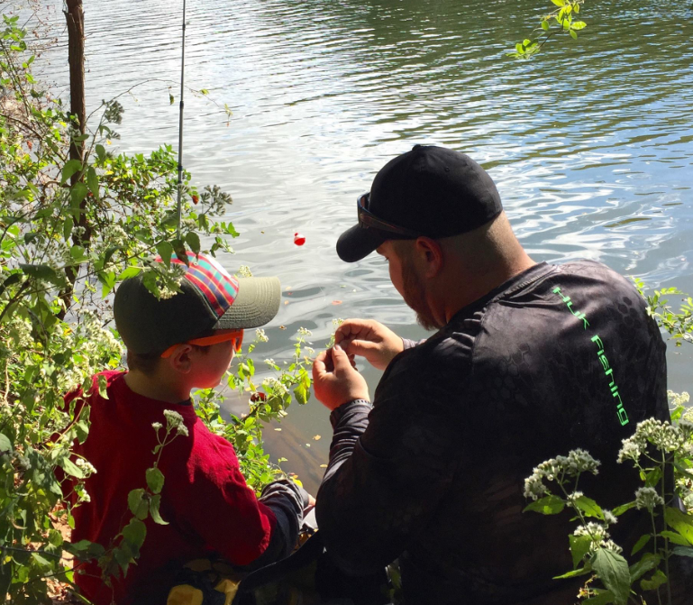
WHITLEY’S NUTS
Notes:
Veronica -

Slide 44
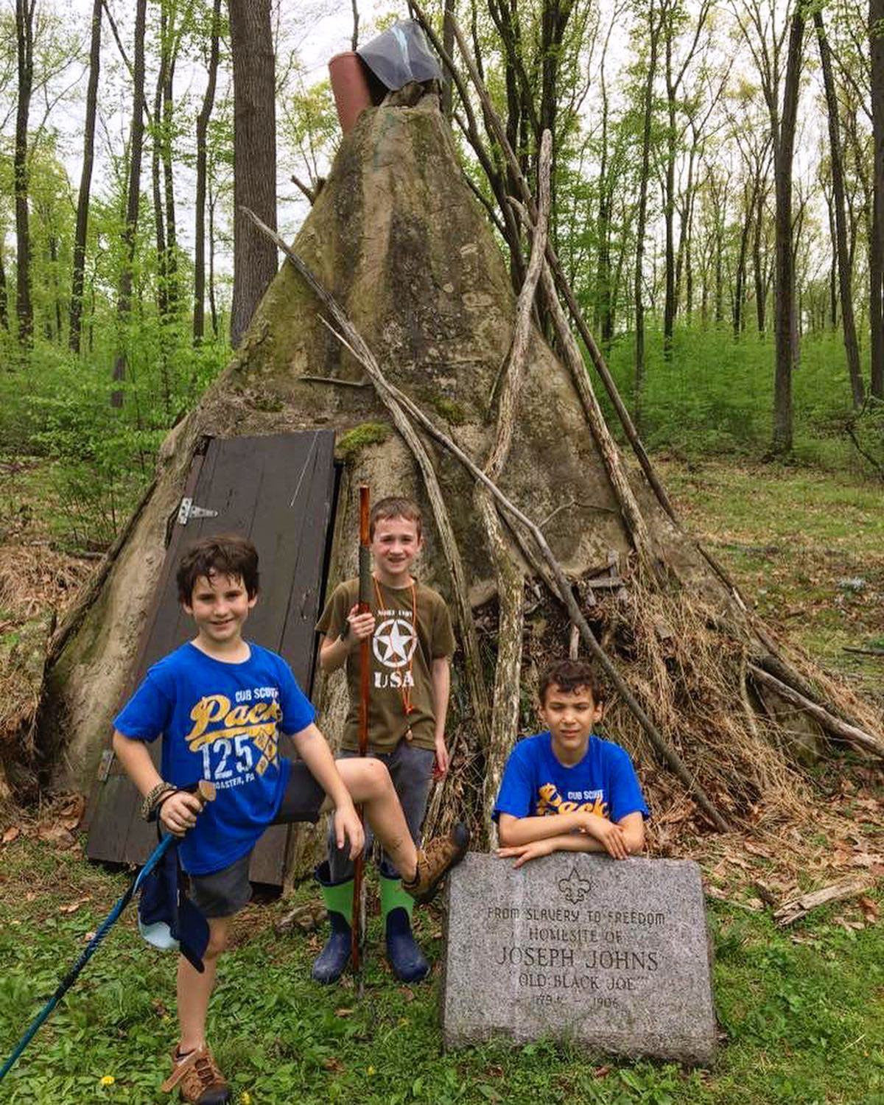
WHITLEY’S NUTS
Show & Sell Orders
Go to http://padutchbsa.org
Under Fall Product Sale use
Take Order Orders
Go to http://padutchbsa.org
Under Fall Product Sale use
Notes:
Veronica –
Ordering nuts is the same as last year. On the PA Dutch Council Fall Product Sale page are two buttons to order nuts. One is expressly for Show & Sell orders (this includes supplemental Show & Sell orders). The other is only for the Take Order part of the sale.
Whitley’s is working on an online order system.

Slide 45
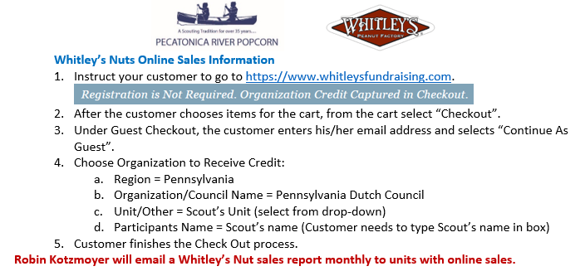
WHITLEY’S NUTS
Online Orders
Notes:
Veronica –
Whitley’s does have an online store. The product line up is not exactly the same as the Take Order flyer. Familiarize yourself with the product available to offer to your customers. Scouts do not set up an online page that is tied to the online store. Instead, the customer will use the Guest Checkout, enter their email address and Continue As Guest. A page will pop up to allow them to choose the organization to receive credit. The Scouts give their online customers their specific information to be credited with the sale.
Region = Pennsylvania
Organization/Council Name = Pennsylvania Dutch Council
Unit/Other = Scout’s Unit (there will be a drop down from which to select the unit)
Participants Name = Scout’s name (the customer will need to type the Scout’s name in the box)
Whitley’s online sales business cards are available on the PA Dutch Council Fall Product Sale page. Look for the link.

Slide 46
PRODUCT PICK UP & RETURNS
Warehouse Locations
Lebanon County
Ziegler’s Distribution (Lebanon Valley Business Park)
27 Lebanon Valley Parkway
Lebanon, PA 17042
Lancaster County
Sears Auto Center Building (West parking lot of Park City)
805 Plaza Boulevard
Lancaster, PA 17601
Notes:
Roger H –
This year we have two warehouses where we will receive, sort and distribute popcorn and nuts.
The entrance for the Lebanon Valley Business Park is on State Drive about 1 mile north of the State Drive intersection with Route 419.
The Lancaster warehouse is in the parking lot of Park City Mall. Entrance is on Plaza Boulevard.

Slide 47
PRODUCT PICK UP
Show & Sell
Initial Order – Scheduled pick up at warehouse of choice
Reorders – Scheduled pick up at Lancaster Warehouse
Take Order
Scheduled pick up at warehouse of choice
* We need volunteers to help at both warehouses!
For sorting and distribution at both warehouses
Contact Roger Harvey (Lancaster) or Myrna Walker (Lebanon)
Notes:
Roger H –
The first Show & Sell order will use both warehouses. Product will be delivered to both, based on selection at registration for the sale. We will need lots of volunteers all three days to help at each warehouse.
If each unit sends at least one volunteer to assist, we should have plenty of help.
The three supplemental Show & Sell orders will most likely be delivered to and picked up from the Council office. Volume of orders will determine where this happens.
If you order supplemental product, be sure to have someone available to pick up the order. We hope to have supplemental orders ready for pick up within seven days, but that will be dependent on product delivery. You will be contacted when your supplemental order is ready for pick up.
Show & Sell returns will be accepted only at the Lancaster warehouse.
The two warehouses will also be used to receive, sort and distribute the Take Order product. Again, we will need lots of volunteer help.

Slide 48
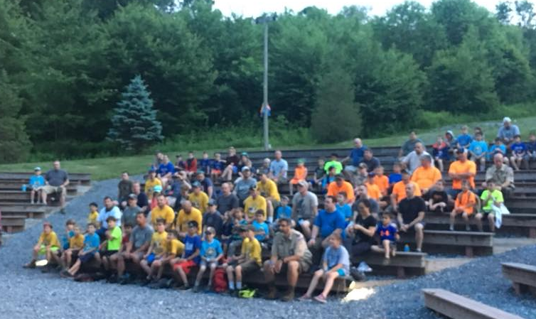
PRODUCT PICK UP
Tips For Pick Up
Bring your order documents
Bring enough people and vehicles
to transport your entire order
Bring help to load your order
INSPECT YOUR PRODUCT FOR DAMAGE
(Damaged product MUST be reported to Robin Kotzmoyer & returned to the Council Office within 7 days of pick up.)
Notes:
Roger H –
Your pick up time will be scheduled. Please keep your scheduled time. Each unit is allotted time to check the order, sign the paperwork and then load the product.
We recommend that you print out and have in hand your order paperwork to compare with Council’s paperwork at the warehouse.
Please bring enough help and vehicles with you to load and transport your order in one trip.
Please check your order for damage right away. We want the opportunity to replace any damaged product in a timely manner.

Slide 49
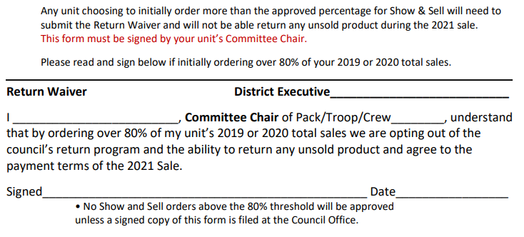
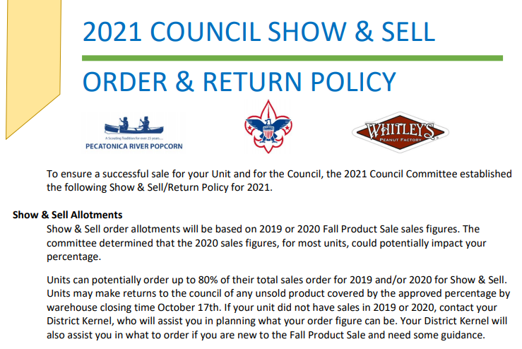
PRODUCT RETURNS
This form must be signed by your unit’s Committee Chair.
Notes:
Roger H –
Since we know that some of your unit’s sales were impacted by the pandemic, the Committee chose to allow your unit’s percentage to be based on your 2019 or your 2020 sales. We do ask that you take several things into consideration when placing your Show & Sell order.
Does your unit have a solid plan for Show & Sell?
Are your families committed?
How many youth do you have this year in comparison to 2019 and 2020?
Remember that you can place additional orders during the Show & Sell portion of the sale.
Keep in mind that payment is expected when you pick up your additional product and that additional product cannot be returned.
Please note that should your unit want to order more than 80%, your unit’s Committee Chair will need to sign the 2021 Council Show & Sell Order & Policy Return paper.

Slide 50
PRODUCT RETURNS
Show & Sell Returns
ONLY the Lancaster Warehouse
(Do not return popcorn to the Council Office)
Sunday; 10/17/21 – times will be scheduled
Show & Sell Payment
2021 Product Sale Show & Sell Order Return Policy
Damaged product will not be accepted
Do not tape opened boxes
Return product in original cases
Notes:
Roger H –
Show & Sell product returns will be accepted at the Lancaster warehouse by appointment.
If you are ordering Show & Sell product, please make arrangements with someone in your unit now to be available to return product on Sunday, October 17th.
Make arrangements with your unit Treasurer to have payment for product not returned, so payment can be turned into Council staff with your returned Show & Sell product.
Please review the Show & Sell Order Return Policy to avoid any confusion about what can be returned. If you have any questions about returning your product, please contact your District Executive or your District Popcorn Kernel.
Damaged product will not be accepted during returns. Damaged product needs to be returned to the Council office right away.
Once you open a case, do not tape it shut. All cases that were opened will checked to assure an accurate inventory of returned product.
Please return the product in the original case whenever possible. This allows us the ability to package product in corresponding cases for inventory. This also gives us the opportunity to use any empty cases to sort Take Order product.
We will need volunteers to help with returns. Please let us know if you have someone who can assist us.

Slide 51
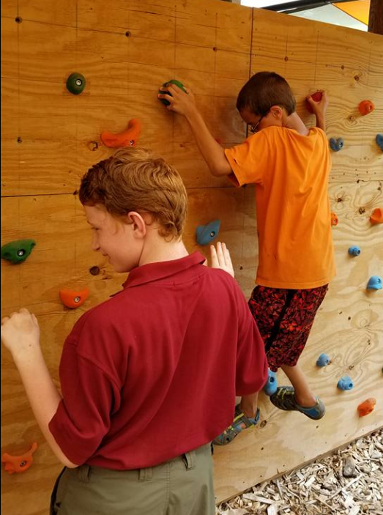
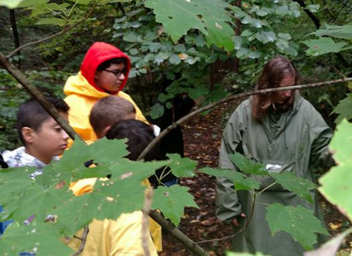
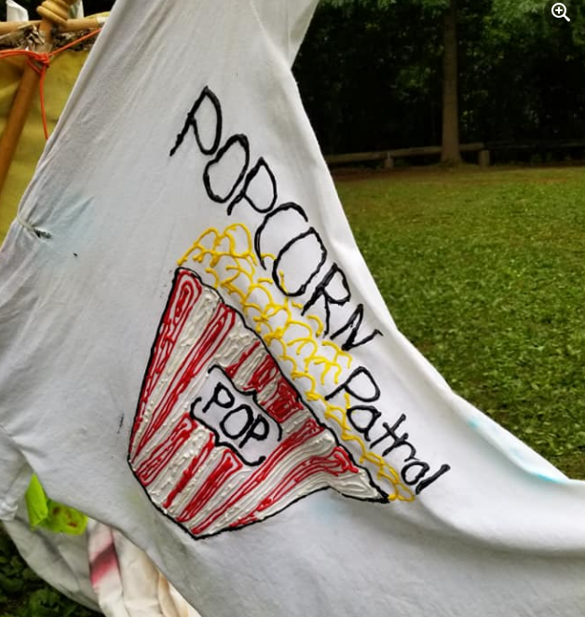
UNIT TO UNIT TRANSFERS
Notes:
Myrna -

Slide 52
UNIT TO UNIT TRANSFERS
Notes:
Myrna –
A decision was made to continue to use the Unit to Unit Transfers form for all transactions between units.
Please note that it is set up with Show & Sell popcorn and nuts. The sheet was set up to allow you to calculate the value of the product transfer.
Both units which are part of the transfer should have a signed copy of this form to file with the Fall Product Sale records. A copy of this form must be submitted to the Robin Kotzmoyer at the Council Office.
Please note that no transfer is official until Robin has a copy. Be timely with sending your form to Robin.
Should you be a unit representative for more than one unit and those units want to make a product transfer, the Council highly recommends having other leadership sign the paperwork.

Slide 53
RESOURCES
GUIDEBOOK
Notes:
Myrna –
You will find a lot of information on the PA Dutch Council Fall Product webpage.
If you have not already committed to the sale, use the “Commit your unit to the Product Sale button.
You will also find the buttons to order nuts for Show & Sell and nuts for Take Order. Should you need to order more Show & Sell popcorn, utilize the Show & Sell button. Please check the calendar for order deadlines.
You have a hard copy of the Guidebook in your Kernel Tool Kit, but you can also access a link to the Guidebook on the website.
Please take the time to read through the booklet. We have some new information and important information.

Slide 54
RESOURCES
ADVERTISING IDEAS
DRIVE THROUGH SALES
Notes:
Myrna –
Along with the Guidebook, you will find links to important pages in the Guidebook. as well as some links to information that we thought may be helpful to you and your unit.
Advertising Ideas. Some creative ideas to make your sales more noticeable and appealing.
Drive Through Sales information.

Slide 55
RESOURCES
ADVERTISING IDEAS
DRIVE THROUGH SALES
FUN UNIT KICKOFF IDEAS
YOUR FUN-RAISER KICKOFF
Notes:
Myrna -

Slide 56
RESOURCES
KERNEL CHECKLIST
SUGGESTED UNIT INCENTIVES
Notes:
Myrna -

Slide 57
RESOURCES
KERNEL CHECKLIST
SUGGESTED UNIT INCENTIVES
PLANNING/GOAL SETTING WORKSHEET
SCOUT PICKUP/SETTLEMENT FORM
Notes:
Myrna -

Slide 58
RESOURCES
WHITLEY’S FORM
PECATONICA RIVER FORM
Notes:
Myrna -

Slide 59
RESOURCES
WHITLEY’S FORM
PECATONICA RIVER FORM
INCENTIVE PRIZE FORM
WHITLEY’S ONLINE HANDOUT
Notes:
Myrna -

Slide 60
2021 FALL PRODUCT SALE
PA Dutch Council
THANK YOU!
Notes:
Joe and Matt –

Slide 61
2021 FALL PRODUCT SALE
PA Dutch Council
QUESTIONS?
Notes:
Joe and Matt –

