Slide 1
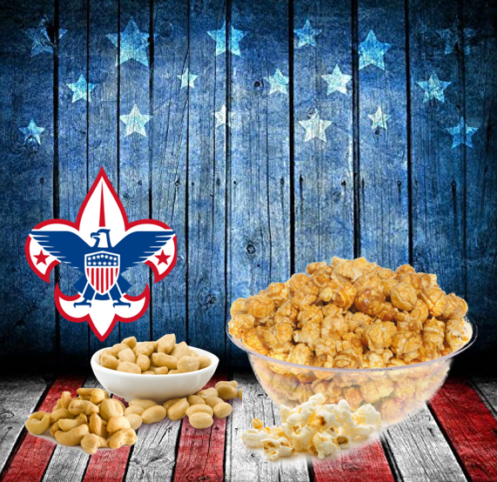
2022 FALL PRODUCT SALE
PA Dutch Council
Notes:
Joe – Welcome

Slide 2
THE PA DUTCH COUNCIL TEAM
Joe Flaim
Council Kernel
Matt Adams
Staff Advisor
Robin Kotzmoyer
Council Support
Iron Forge
District
Nicole Welch – DE
Vacant –DK
April Sherk
Veronica Swope
Myrna Walker
Council Sale Support
Susquehanna District
Sheila Fasig – DE
Roger Harvey – DK
Erin Brossman
Rob Doyle
Notes:
Joe – Introduce team
Thank helpers – Robin and Dave Kotzmoyer - Amy McKelvy

Slide 3
OUR 2022 PARTNERS
Notes:
Joe – Talk about vendors

Slide 4
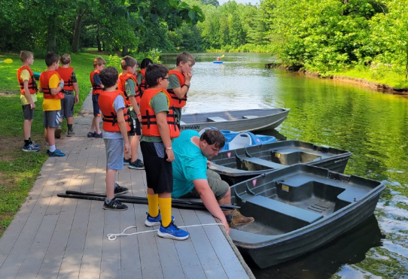
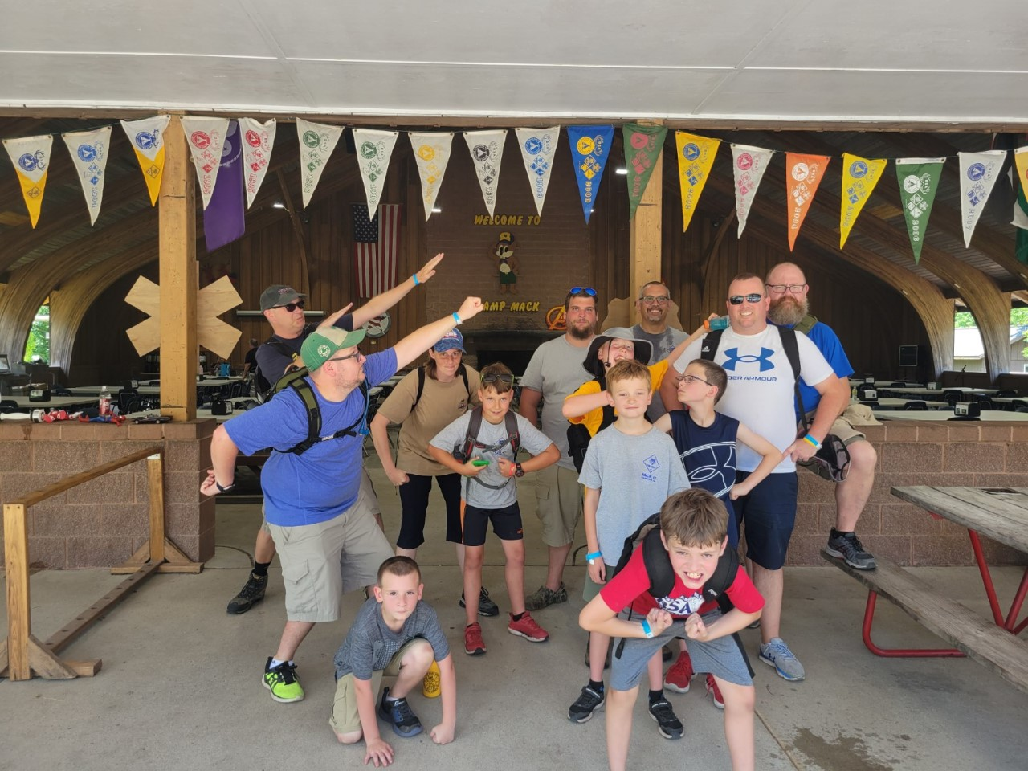
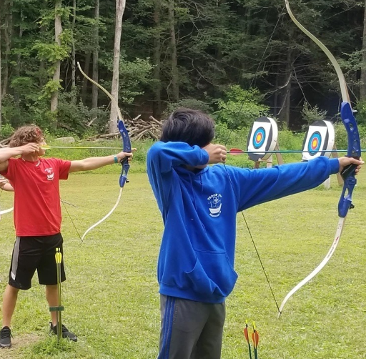
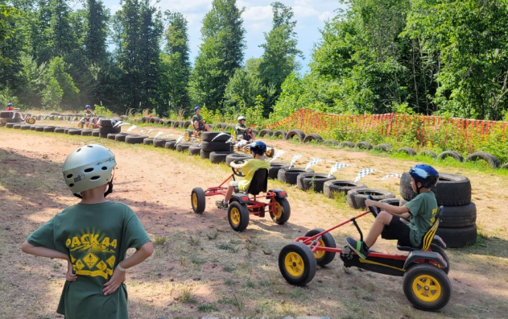
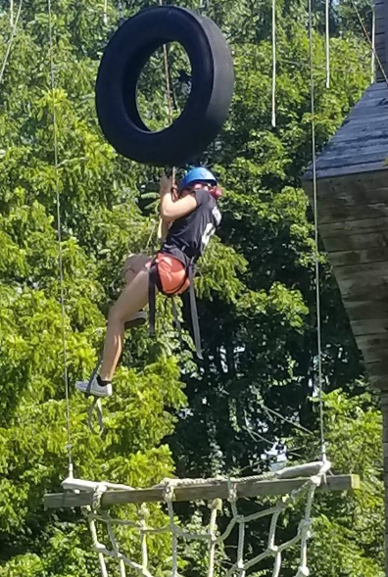
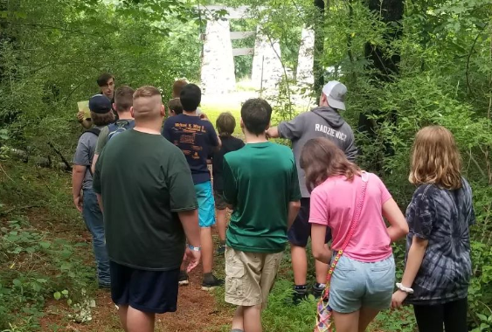
WHAT DID YOUR UNIT DO?
Notes:
Joe

Slide 5
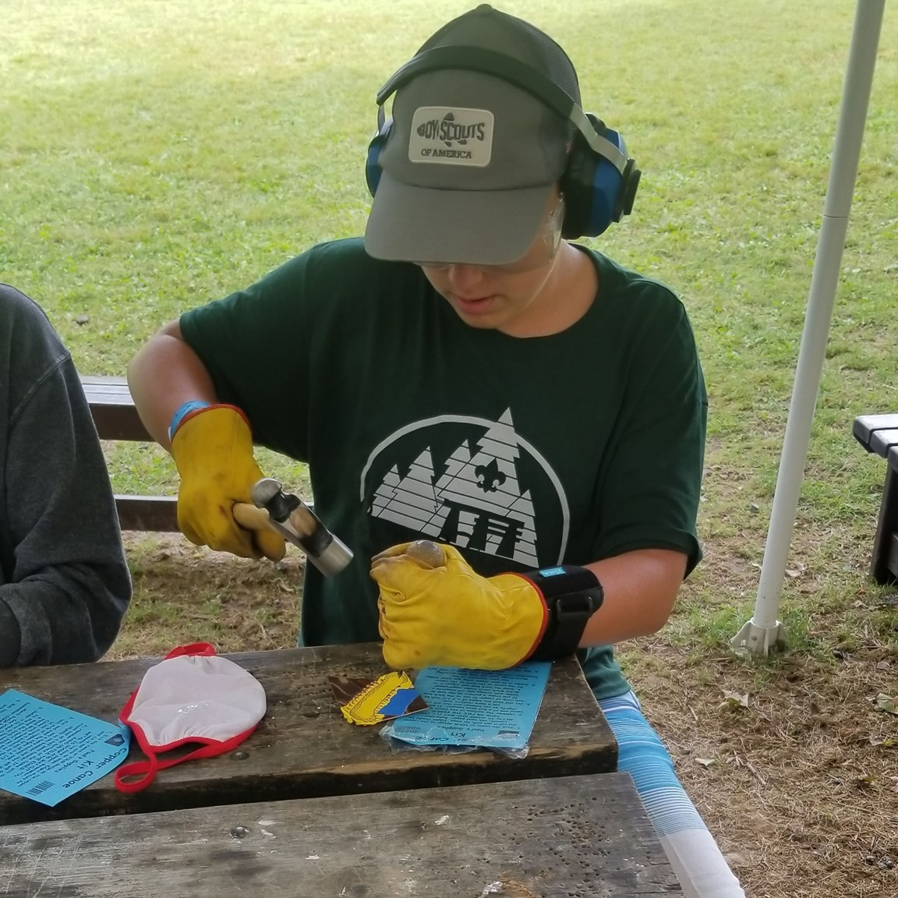
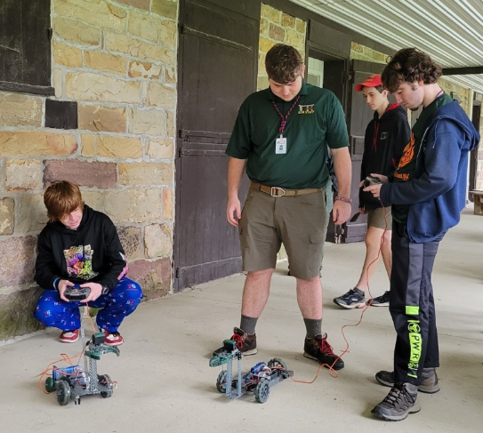
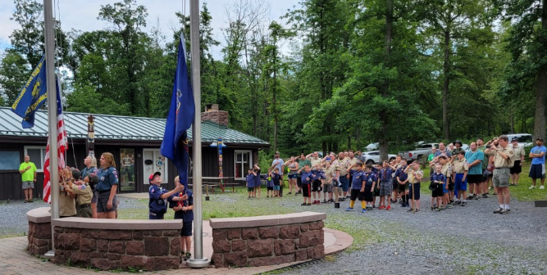
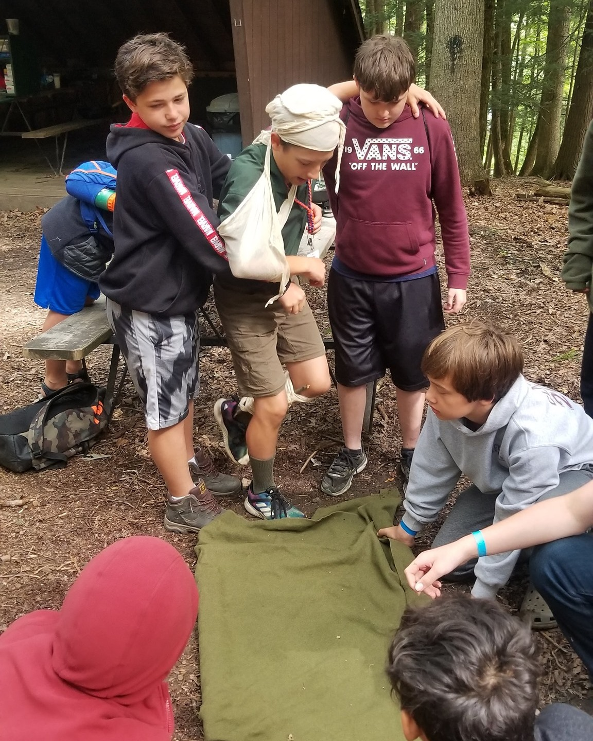
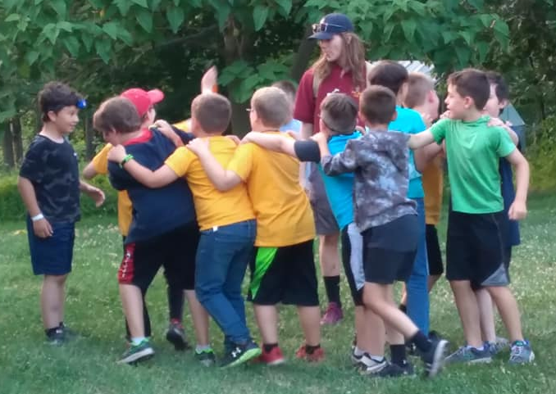
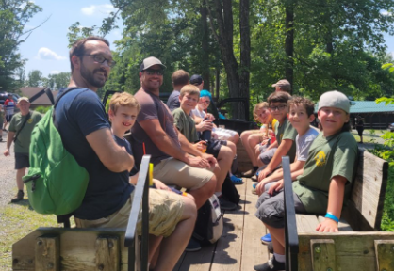
SCOUTING IS POSSIBLE BECAUSE OF SCOUTERS LIKE YOU!
Notes:
Joe

Slide 6
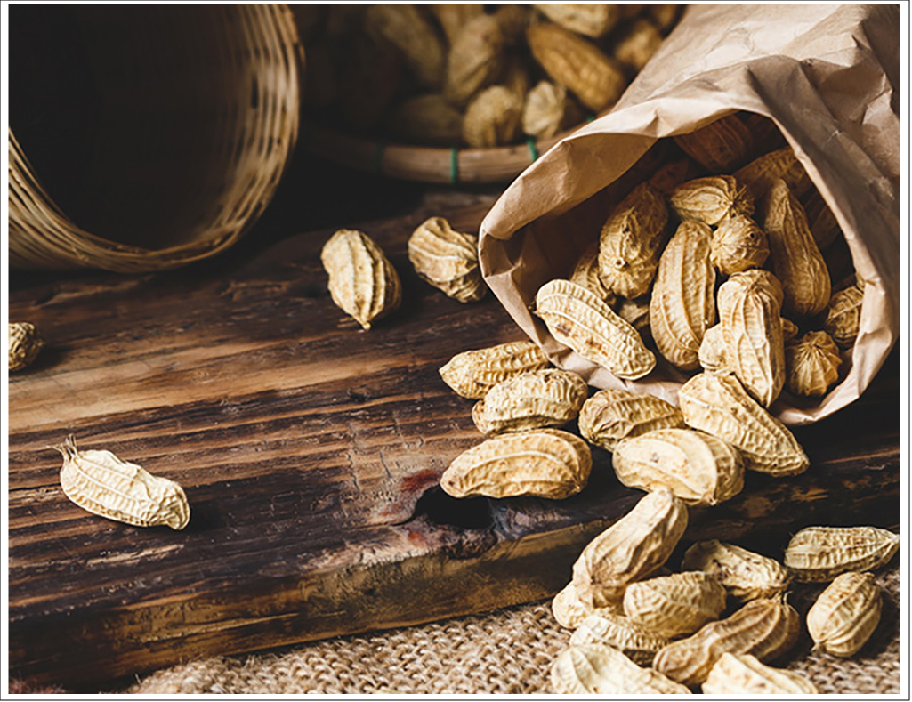
BREAKING NEWS!
Notes:
Matt – Thank you to all the units who participated last year. Sold more than $300,000.00.

Slide 7
TOP SELLING UNITS
IRON FORGE DISTRICT
BREAKING NEWS!
Pack 44 $ 49,595.00
Troop 456B $ 10,350.00
Pack 3204 $ 8,335.00
Notes:
Matt
Pack 44 – Veronica Swope Troop 456B – Amy McKelvy Pack 3204 – Kevin Grant

Slide 8
TOP SELLING UNITS
IRON FORGE DISTRICT
BREAKING NEWS!
Pack 44 $ 49,595.00
Troop 456B $ 10,350.00
Pack 3204 $ 8,335.00
TOP SELLING UNITS
SUSQUEHANNA DISTRICT
Pack 125 $ 24,930.00 Pack 19 $ 16,000.00
Pack 82 $ 12,365.00
Notes:
Matt
Pack 125 Erin Brossman Pack 19 Ashley Messer Pack 82 Andrea Mull

Slide 9
Set your sales goal
Conduct a fun and exciting kickoff
TOP SELLING UNITS
IRON FORGE DISTRICT
BREAKING NEWS!
Use unit incentives
Pack 44 $ 49,595.00
Troop 456B $ 10,350.00
Pack 3204 $ 8,335.00
Communicate with your Scout families
TOP SELLING UNITS
SUSQUEHANNA DISTRICT
Pack 125 $ 24,930.00 Pack 19 $ 16,000.00
Pack 82 $ 12,365.00
Participate in all methods of selling
Notes:
Matt
You can achieve great success too. Set your sales goal – Conduct a fun and exciting kick off – Use unit incentives – Communicate with your Scout families – Participate in all methods of selling.

Slide 10
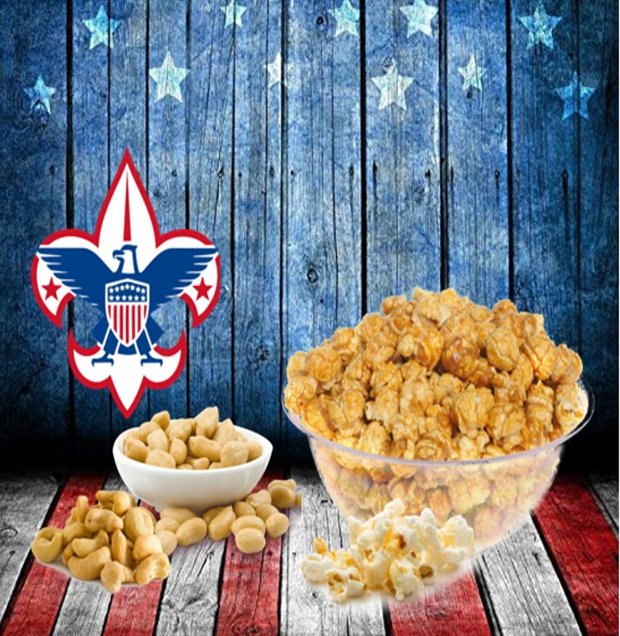
2021 TOP SELLERS
Pack 44 James Spead 10,125.00
Pack 146 Stryker Hart 5,253.00
Pack 44 Liam Arpey 5,157.00
15 Scouts sold more than 3,000.00
Pack 44 Landon Dippner 5,007.00
Pack 3204 Kayla Grant 4,395.00
Troop 439 Nathan Yang 4,095.00
Troop 44 Mark Spead 4,060.00
Pack 44 Austin Moyer 3,987.00
Pack 44 Cohen Ditmer 3,905.00
Pack 44 Easton Arpey 3,506.00
Pack 82 Cheyenne Pedrick 3,371.00
Troop 142 Ethan Dippner 3,332.00
Troop 58 Johnny Kuhl 3,230.00
Pack 19 Wyatt Messer 3,138.00
Pack 37 Spencer Rippley 3,017.00
Notes:
Matt – Names will load in one by one from lowest to highest

Slide 11
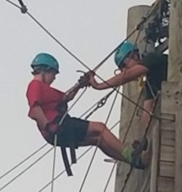
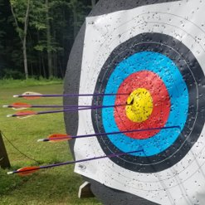
2021 TOP SELLERS
You can do it too!
15 Scouts sold more than 3,000.00
Notes:
Matt

Slide 12
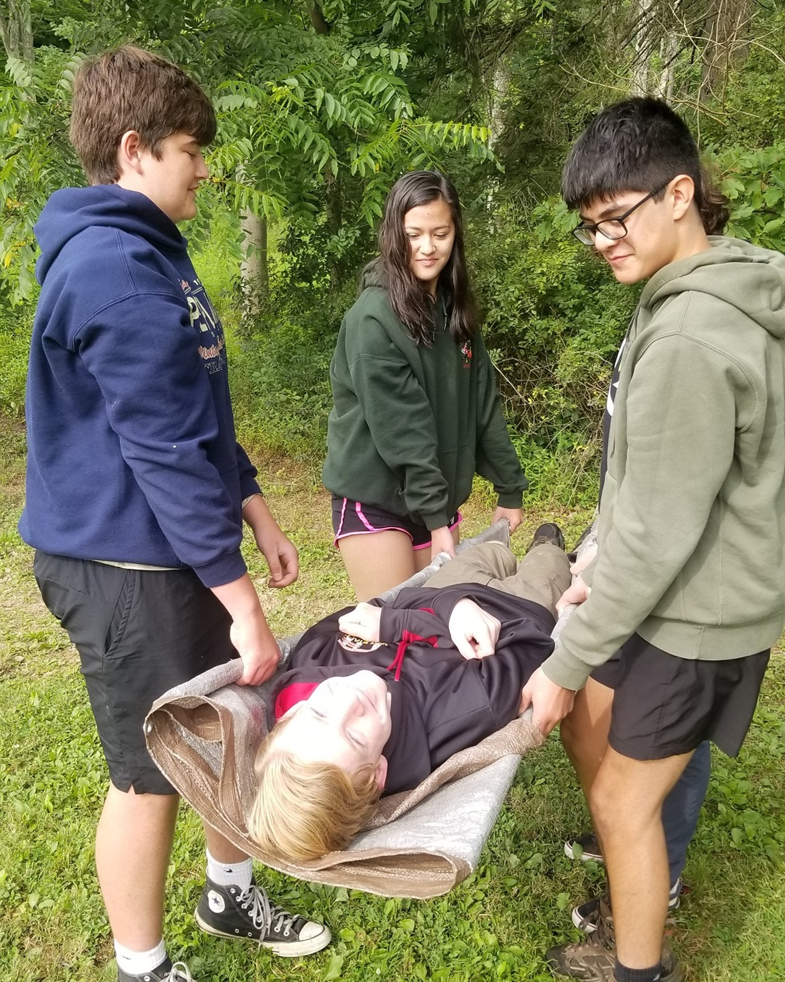
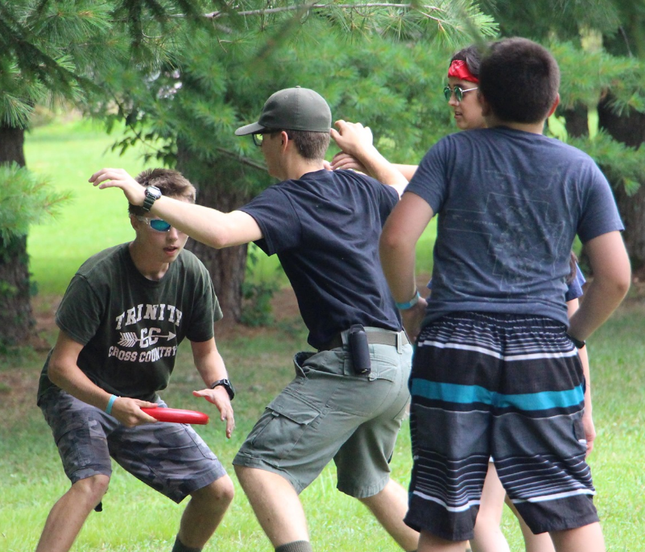
TONIGHT'S
AGENDA
Product Updates
Methods of Selling
2022 Commissions & Incentives
Pecatonica River System
Tips and Best Practices
Whitley’s Nuts
Resources
Notes:
Myrna

Slide 13
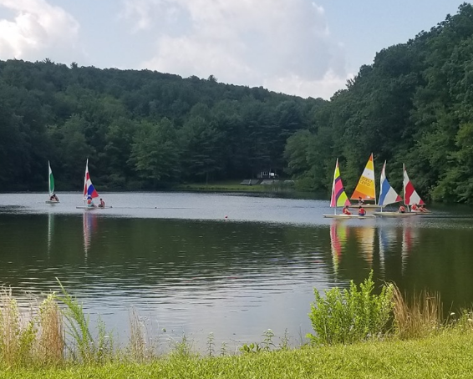
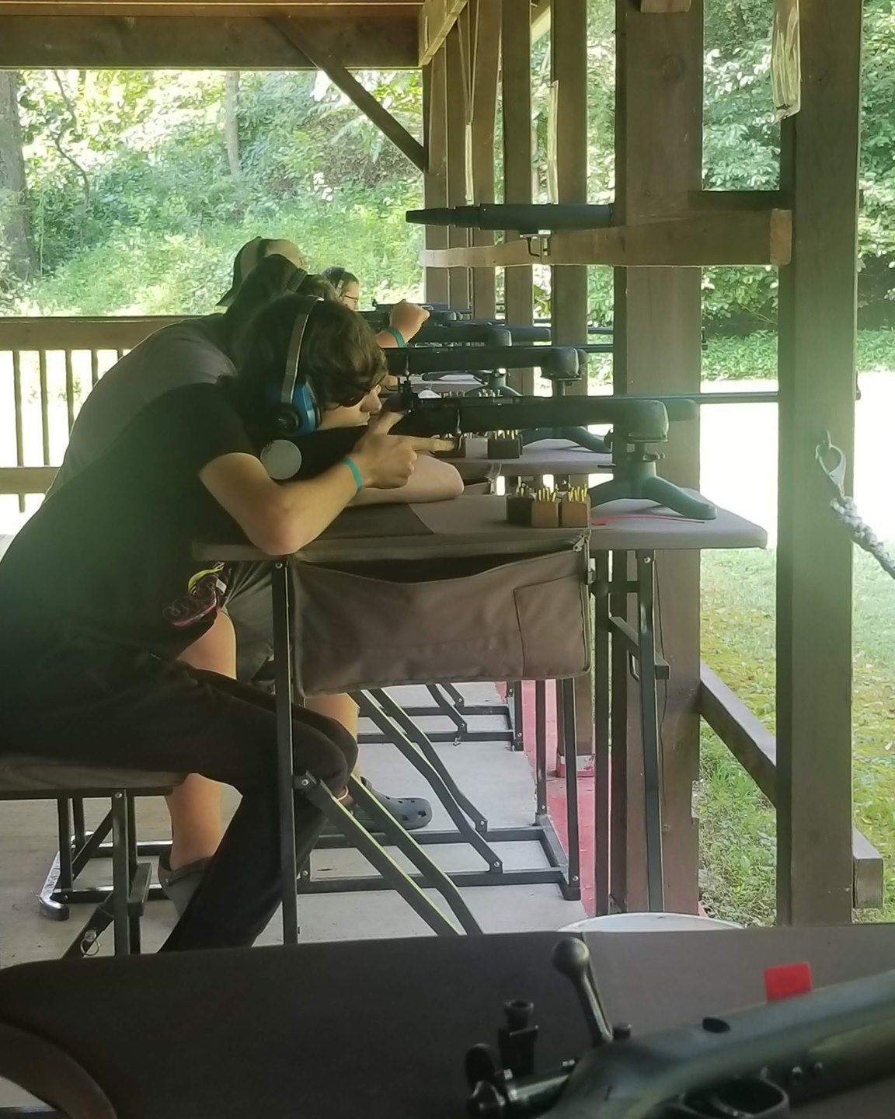
2022 DATES
7/14 Fall Product Kickoff
7/21 Selling Techniques Webinar
7/28 Ordering Webinar
8/1 Sale Begins
8/2 Show & Sell Orders Due
8/24 Product Sort at Warehouses
8/25 Product Distribution
9/8 Additional Orders Due
9/16 Additional Order Delivery
9/22 Additional Orders Due
9/30 Additional Order Delivery
10/13 Show & Sell Returns
10/14 Show & Sell Returns
(Under Product Pick Up & Returns - 10/17 for returns is incorrect!)
10/17 Take Orders Due & Prize Orders Due
10/31 Show & Sell Money Due
11/9 Product Sort at Warehouses
11/10 Product Distribution
11/30 Take Order Money Due
Notes:
Myrna

Slide 14
PATH TO ADVANCEMENT
Notes:
Myrna – There are multiple opportunities to use Fall Product sales to advance in Scouting.

Slide 15
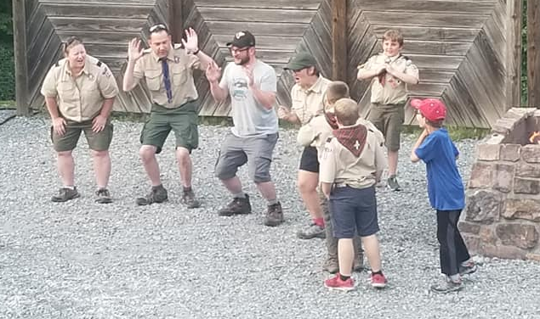
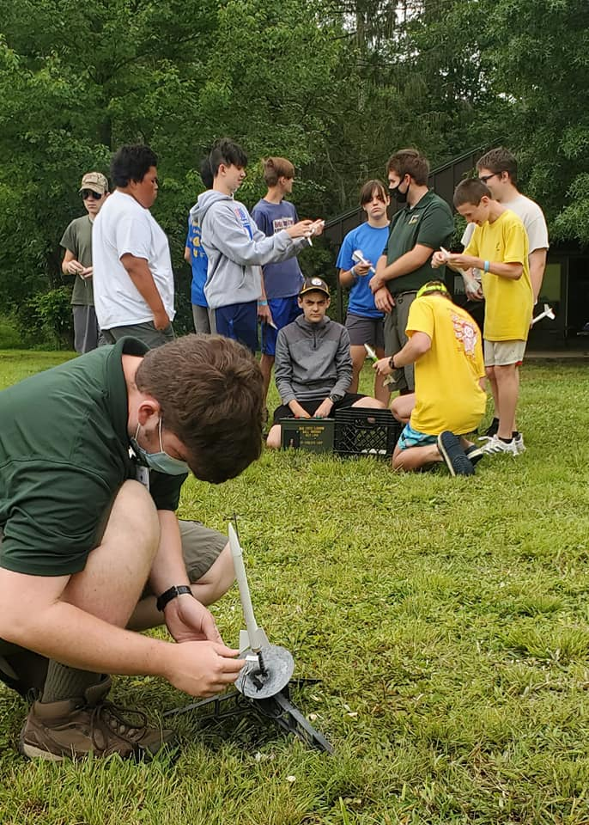
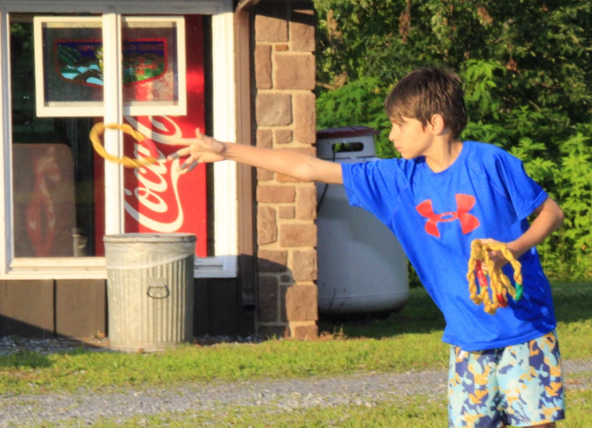
2022 PRODUCT
Notes:
Myrna

Slide 16
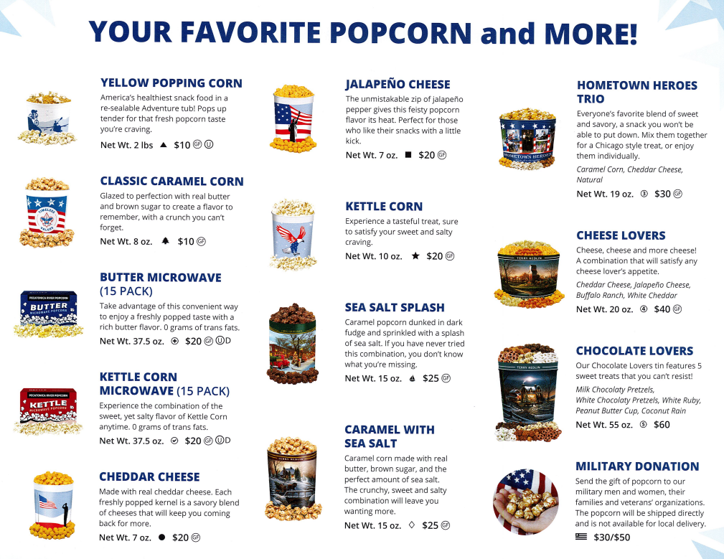
NEW!
Show & Sell
Product
Notes:
Myrna – One of the advantages of us working with New Birth of Freedom Council, Hawk Mountain Council, and Chester County Council – we leveraged keeping the retail price of popcorn the same as last year.
Pecatonica River reduced the number of microwave packs in the butter microwave and the kettle corn microwave from 16 to 15 packets. Review Show & Sell. NEW! – popped kettle corn in a bucket. No Penn State tin this year.

Slide 17
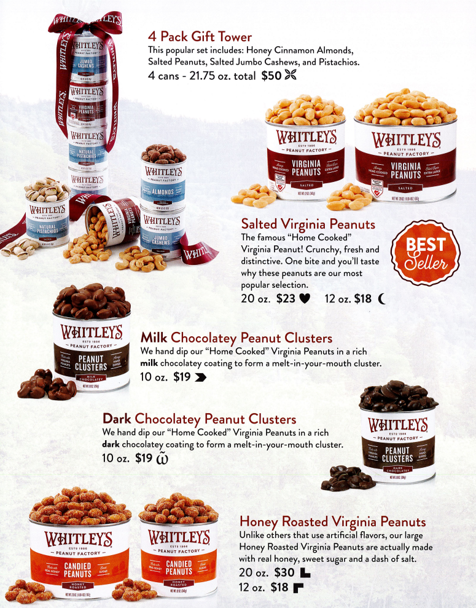
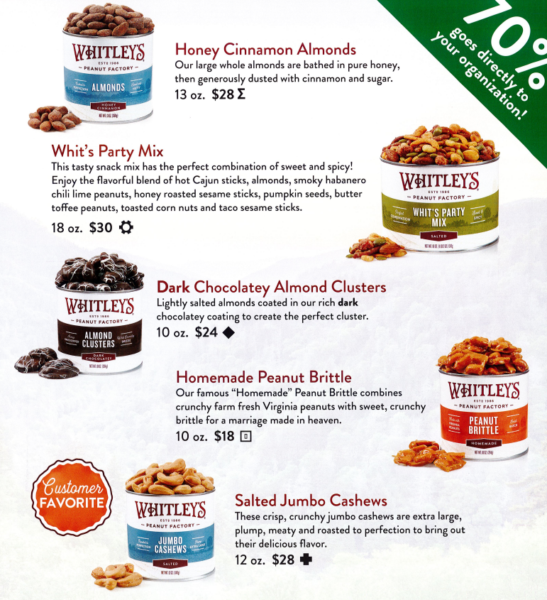
NEW!
NEW!
Show & Sell
Product
Notes:
Myrna – Unfortunately we were not able to leverage pricing with Whitley’s. In addition to the price increase for the product, they changed a couple other items. The 5 pack gift pack is now a 4 pack tower and the dark chocolate peanut clusters was reduced from 24 oz to 10 oz due to supply chain issues. Please note that Whitley’s is not participating in the Military sales this year. People who want to support Scouting by supporting our military troops will need to do so through popcorn.

Slide 18
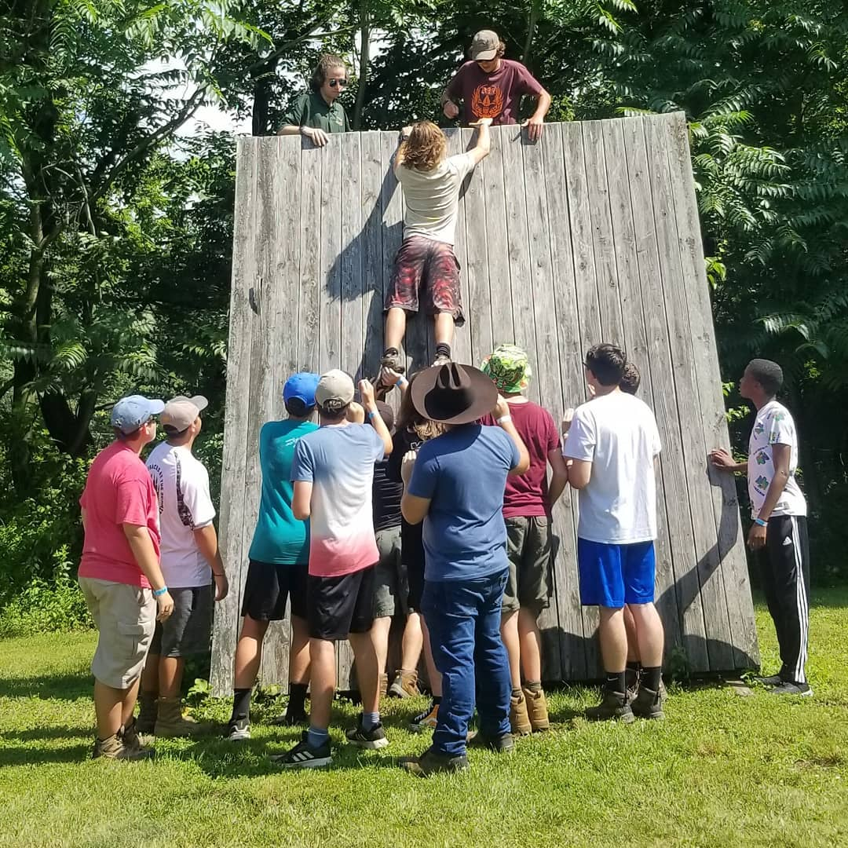
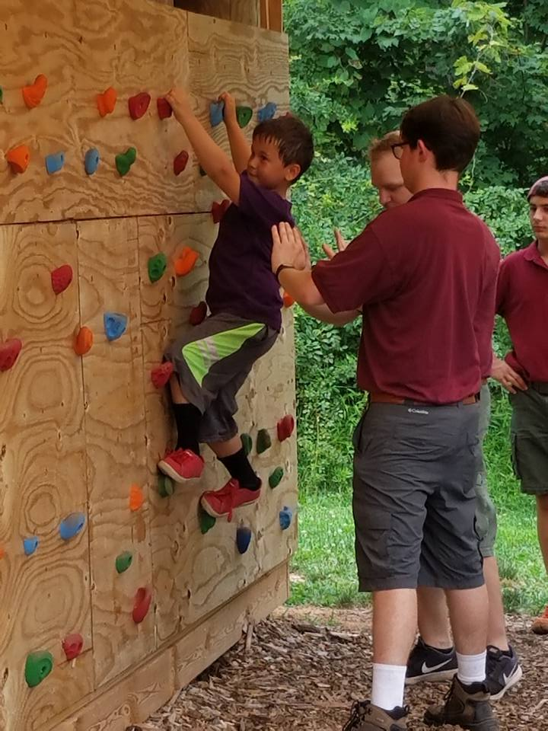
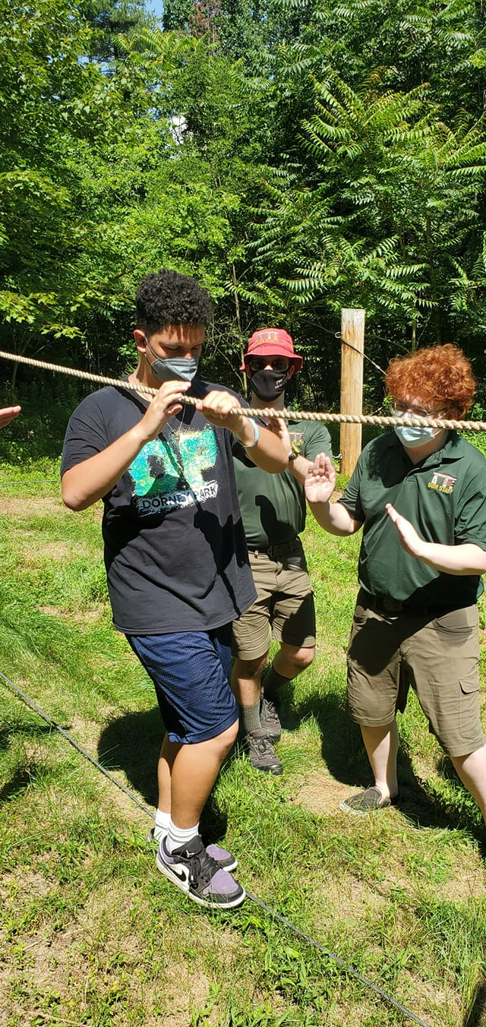
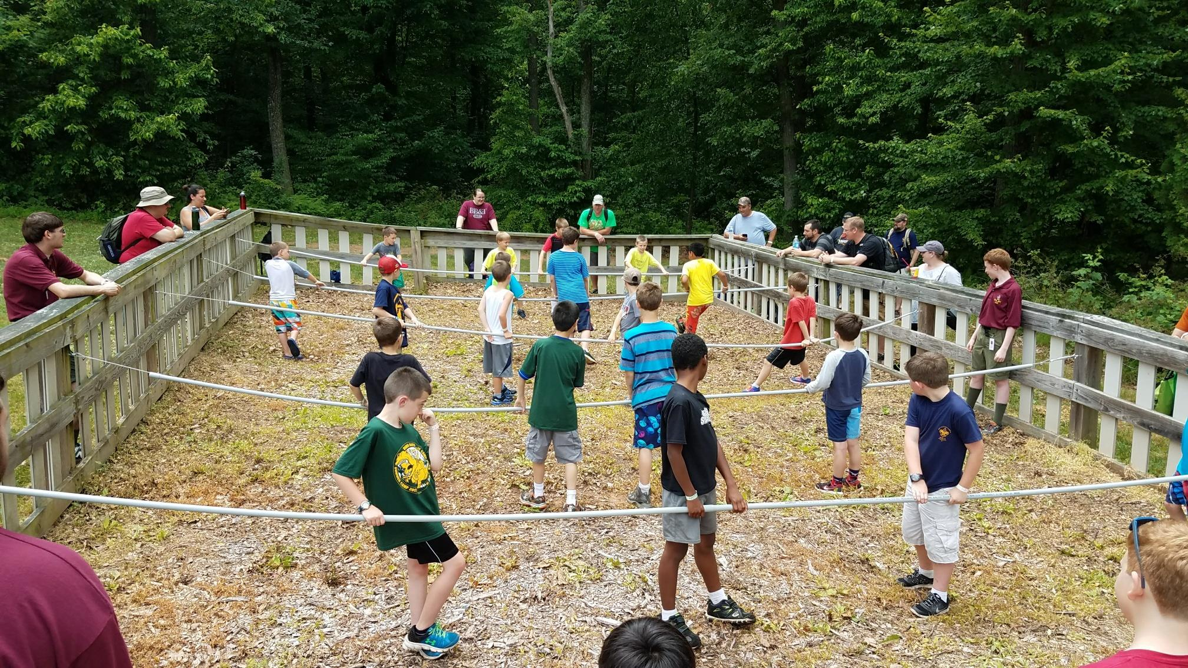
METHODS OF SELLING
Notes:
April

Slide 19
Notes:
April

Slide 20
Credit card sales should be paid directly into the unit checking account.
Notes:
April

Slide 21
Notes:
April

Slide 22
KELLER
PRIZE
SHEETS
WHITLEY’S
ORDER FORMS
Notes:
April

Slide 23
Notes:
April

Slide 24
TABLE TENTS
DOOR HANGERS
Notes:
April

Slide 25
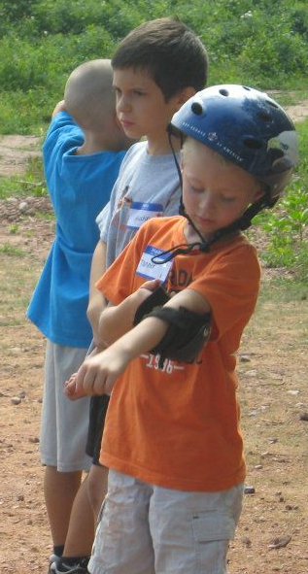
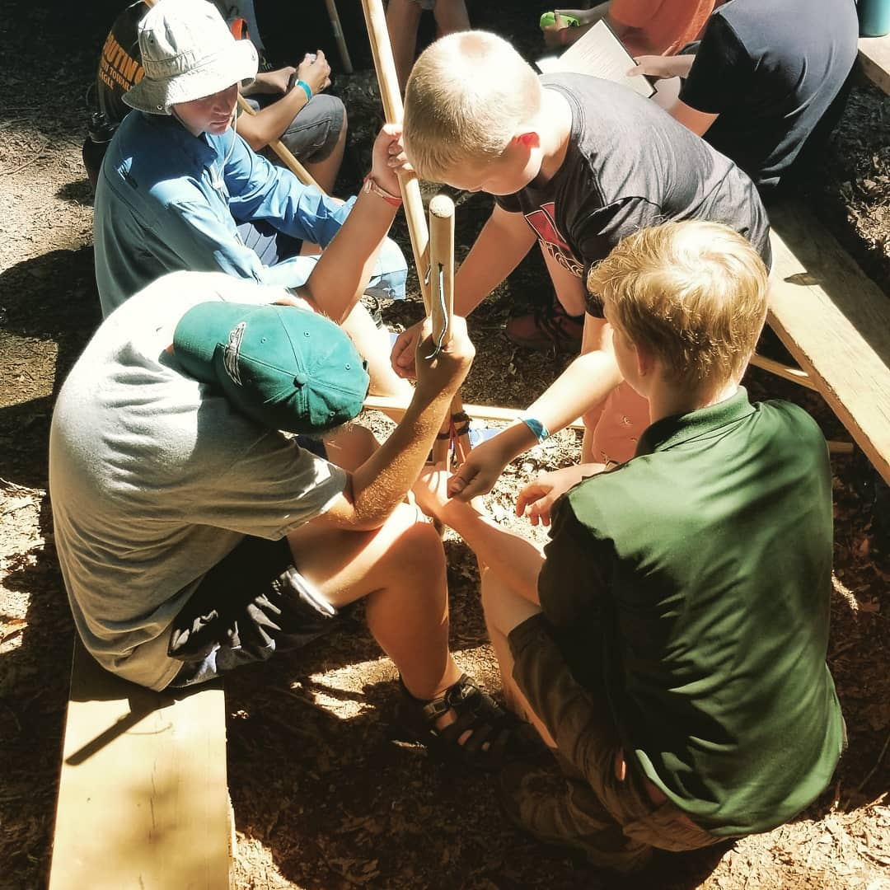
COMMUNICATION
Key to a Successful Sale
Publish Your Sales Dates
Have a Unit Kickoff
Have a celebration
Notes:
April

Slide 26
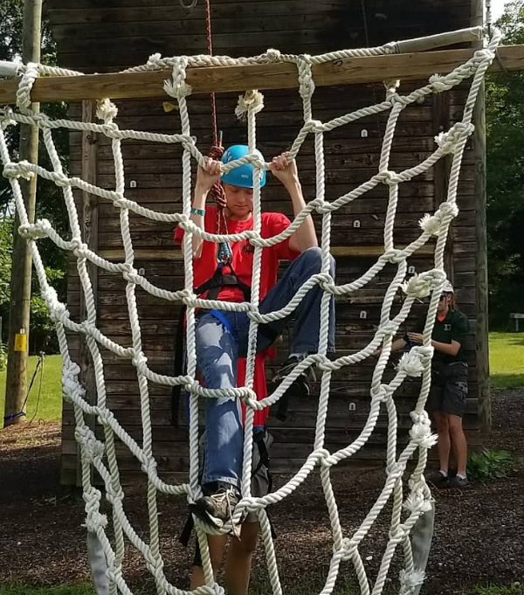
COMMISSIONS & INCENTIVES
Notes:
April

Slide 27
COMMISSIONS & INCENTIVES
INCENTIVE PRIZE OPTION​
​
31% Commission​
Incentive Prizes by Sales Level​
Winner’s Circle Sales Level​
Military Pin​
Top Salesman Pin​
Online Sales Pin
NO PRIZE OPTION​
​
34% Commission​
Winner’s Circle Sales Level​
Military Pin​
Top Salesman Pin​
Online Sales Pin
ONLINE SALES​
​
30% Commission​
Notes:
April

Slide 28
INCENTIVES
Notes:
April

Slide 29
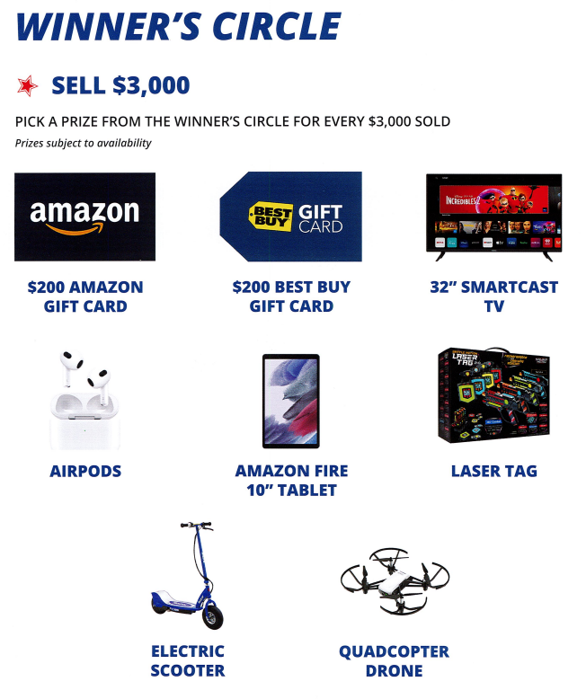
INCENTIVES
WINNER’S CIRCLE​
​
Regardless of the prize option chosen by the Unit, any ​
Scout who sells more than ​
$ 3,000.00 in POPCORN will be able to choose a prize for every
$ 3,000.00 sold.
WINNER’S CIRCLE​
​
POPCORN SALES ONLY ​
Show & Sell + Take Order + Online sales. The Unit will need to attach proof of the Scout’s POPCORN sales under Winner’s Circle in the Pecatonica River System.
Notes:
April

Slide 30
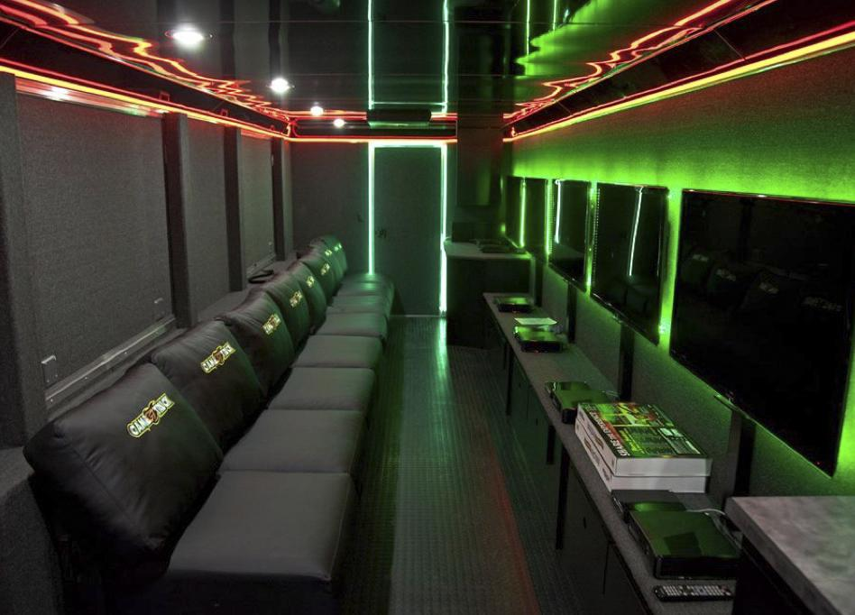
INCENTIVES
COUNCIL INCENTIVE!
Top 50 sellers earn a seat on the game truck!
SATURDAY,
JANUARY 14, 2023
Notes:
April – Last year 36 Scouts sold more than $1,500.00

Slide 31
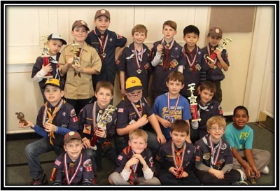
FIVE KEYS TO A SUCCESSFUL SALE
Sales Goal​
Unit Kick-off​
Communication​
Incentives​
Methods of Selling
Notes:
April

Slide 32
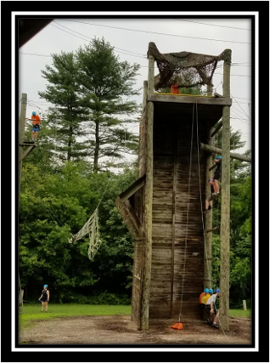
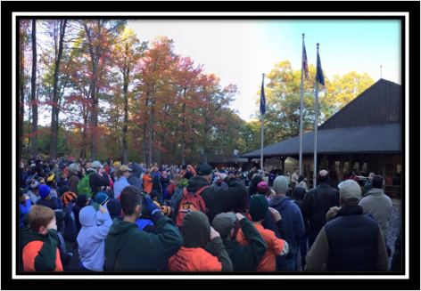
USING THE PECATONICA RIVER POPCORN SYSTEM
Notes:
Myrna

Slide 33
USING THE PECATONICA RIVER POPCORN SYSTEM
Notes:
Myrna – click on My Account – returning Kernels – your password should be the same. If you cannot remember your password, use the forgot my password feature and if that does not work, contact Robin Kotzmoyer or myself. We can reset it for you. If you are a new unit or if you are taking over for last year’s kernel, you should have received an email from me with information on how to access the system. If you did not, please reach out to me so I can give you access. Please check ASAP.

Slide 34
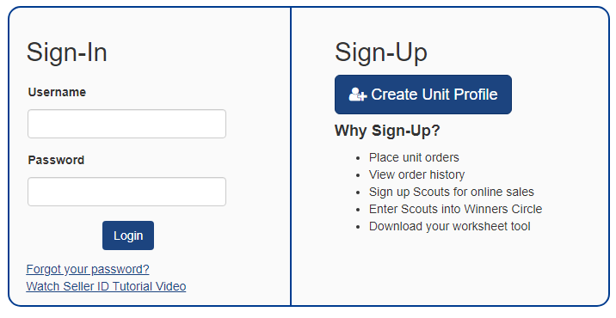
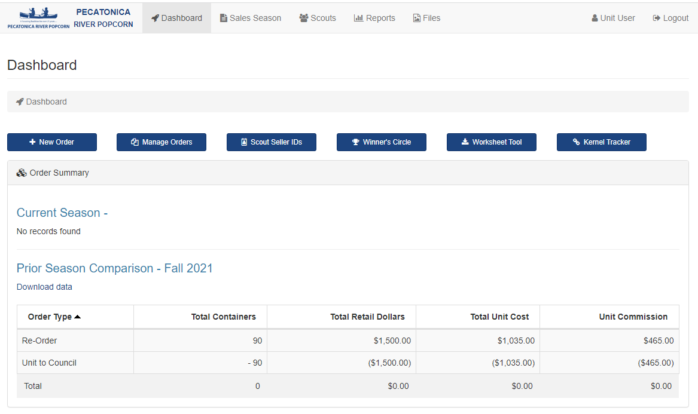
USING THE PECATONICA RIVER POPCORN SYSTEM
Notes:
Myrna – No one needs to Sign-Up – only Sign-In. All units have been established in the system. Once you log in you will see your dashboard.

Slide 35
Notes:
Myrna – Sales season = last year’s information. Scouts = view which Scouts have access to create online account. Reports. Files = saved reports.

Slide 36
Notes:
Myrna – New Order – Manage orders = edit order if not approved – Scout Seller IDs = set up Scouts for online account access – Winner’s Circle = end of sale for $3,000 plus in POPCORN ONLY – Worksheet Tool – spreadsheet to help organize sales to make ordering easier – Kernel Tracker – do we have anyone who used it last year? To talk about it’s features.

Slide 37
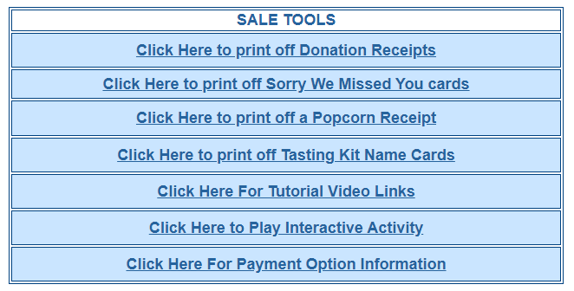
Notes:
Myrna – You are not alone – go to helpful tips on the home page of Pecatonica River – plenty of information – videos to walk you through features of their system. Also a cute interactive activity for Scouts. Anyone can access the home page to access the activity. No need to log in to access it.

Slide 38
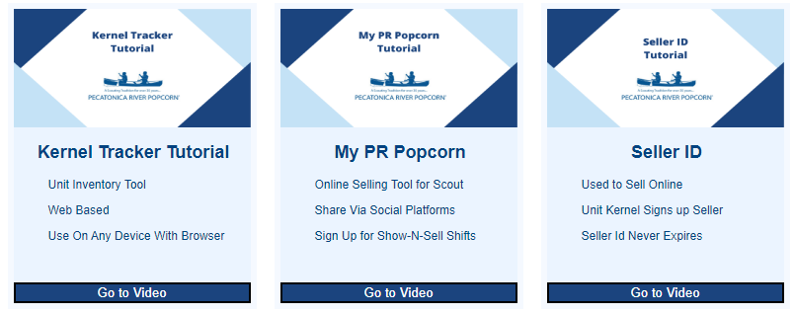
Notes:
Myrna – these 3 video links are a sampling of what is available

Slide 39
ORDERING WHITLEY’S NUTS
Notes:
Myrna

Slide 40
ORDERING WHITLEY’S NUTS
Show & Sell Orders​
Go to http://padutchbsa.org ​
Under Fall Product Sale use
Take Order Orders​
Go to http://padutchbsa.org ​
Under Fall Product Sale use
Notes:
Myrna – Whitley’s does not have a computerized system to order nuts. Utilize the buttons available on the PA Dutch Council website to place orders for nuts

Slide 41
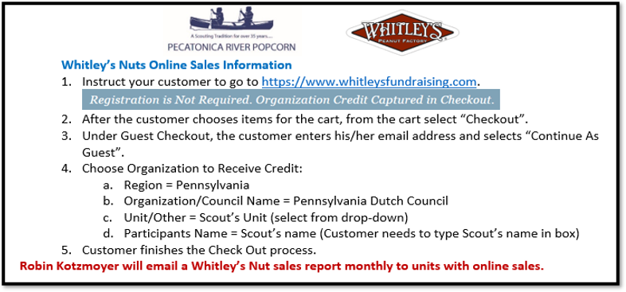
WHITLEY’S NUTS
ONLINE SALES
Notes:
Myrna – Whitley’s nuts can be ordered online – giving credit to the Scout happens during the check out process

Slide 42
CONSIGNMENT SALES
Consignment sales will help:
Units new to Show & Sell and want to try it
Small units
Units with low sales from last year
Units in need of more product
Consignment Orders​
Go to http://padutchbsa.org ​
Under Fall Product Sale use
CONSIGMENT ORDER
Package 3:
(Retail Value $3220)
1 cs Popping Corn
5 cs Caramel Corn
3 cs Butter Microwave
1 cs Kettle Corn Microwave
1 cs Caramel w/Sea Salt
4 Classic Trio
1 cs Salted Peanuts
2 cs Honey Roasted Peanuts
2 cs Cashews
1 cs Whit’s Party Mix
Package 1:
(Retail Value $1032)
2 cs Caramel Corn
2 cs Butter Microwave
1 cs Honey Roasted Peanuts
1 cs Cashews
Package 2:
(Retail Value $2374)
1 cs Popping Corn
3 cs Caramel Corn
2 cs Butter Microwave
1 cs Kettle Corn Microwave
1 Classic Trio
1 cs Salted Peanuts
1 cs Honey Roasted Peanuts
1 cs Cashews
1 cs Whit’s Party Mix
Notes:
Myrna – After Show & Sell orders have been placed and distributed, kernels will have the capability to order consignment through the PA Dutch Council website.

Slide 43
CONSIGNMENT SALES
Consignment sales will help:
Units new to Show & Sell and want to try it
Small units
Units with low sales from last year
Units in need of more product
Consignment Orders​
Go to http://padutchbsa.org ​
Under Fall Product Sale use
CONSIGMENT ORDER
Consignment Orders​
Order using the Consignment button on the Council website
Scheduled pick up (Thursday or Friday)
Return unsold product the following Wednesday before noon
Pay for the sold product (less commission) when returning unsold product
Only available during Show & Sell
Unit may order more Consignment, but only one at a time
Notes:
Myrna – Unsold product needs to be return to the Council office the Wednesday after consignment pick up – gives us time to turn around your unsold product and get it in the hands of another unit – consignment must be paid by Wednesday noon following the pick up even if all is sold

Slide 44
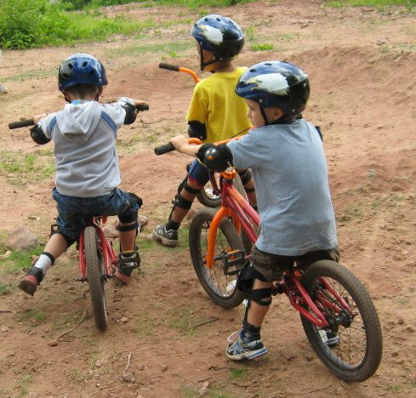
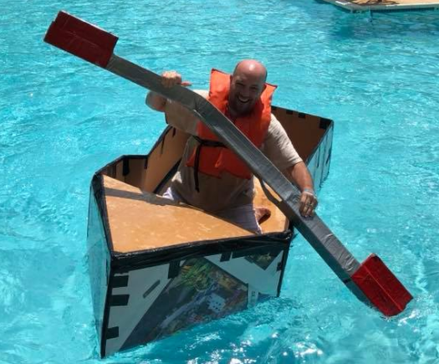
PRODUCT PICK UP & RETURNS
WAREHOUSES
Lebanon County​ (IRONFORGE DISTRICT)
Ziegler’s Distribution (Lebanon Valley Business Park)​
27 Lebanon Valley Parkway​
Lebanon, PA 17042​
​
Lancaster County​ (SUSQUEHANNA DISTRICT)
TBD
​​
Lancaster, PA
Notes:
Joe – explain warehouses

Slide 45
PRODUCT PICK UP
Show & Sell ​
Initial Order – Scheduled pick up at warehouse of choice​
Reorders – Scheduled pick up location TBD​
Consignment
All consignment – Scheduled pick up at Council Office
Take Order​
Scheduled pick up at warehouse of choice​
​​
* We need volunteers to help at both warehouses!​
For sorting and distribution at both warehouses​
Contact Roger Harvey or your District Executive
Tips For Pick Up​
Bring your order documents​
Bring enough people and vehicles to transport your ENTIRE
order​ in one trip
Bring help to load your order​
Empty/organize your vehicle BEFORE pick up
INSPECT YOUR PRODUCT FOR DAMAGE​
(Damaged product MUST be reported to Robin Kotzmoyer &
returned to the Council Office within 7 days of pick up.)
Notes:
Joe – explain product pick up process – pick up scheduled through Sign Up Genius

Slide 46
RETURNS
Show & Sell Returns ​
ONLY the designated Warehouse​ (TBD)
(Do not return popcorn to the Council Office)​
Thursday, 10/13/22 – times will be scheduled​
Friday, 10/14/22 – times will be scheduled
Damaged product will not be accepted​
Do not tape opened boxes​
Return product in original cases
Notes:
Joe – explain returns

Slide 47
Notes:
Joe

Slide 48
Notes:
Joe – timing is very important – paperwork not handed in in a timely fashion will impact the accuracy of your invoices.

Slide 49
Notes:
Joe - Guidebook

Slide 50
PRIZE SAMPLE
RESERVATION FORM
POPCORN MACHINE
RESERVATION FORM
Notes:
Joe – Prize Sample Reservation Form – Popcorn Machine Reservation Form

Slide 51
Notes:
Joe – Advertising Ideas – Drive Through Sales

Slide 52
Notes:
Joe – Fun Unit Kickoff Ideas – Your Fun-Raiser Kickoff

Slide 53
Notes:
Joe – Kernel Checklist – Suggested Unit Incentives

Slide 54
Notes:
Joe – Planning/Goal Setting Worksheet – Scout Pickup/Settlement Form

Slide 55
Notes:
Joe – Whitley’s Flyer – Pecatonica River Flyer

Slide 56
Notes:
Joe – Incentive Prize Form – Whitley’s Online Handout – a cheat sheet to use to identify the Scout during the check out process

Slide 57
2022 FALL PRODUCT SALE
THANK YOU!
PA Dutch Council
Notes:
Joe – THANK YOU!!!

Slide 58
2022 FALL PRODUCT SALE
QUESTIONS?
PA Dutch Council
Notes:
Joe – Question?

