Slide 1
2023 PA Dutch Council Spring Product Sale Unit Summer Camp Fundraising Opportunity For Scouts
Sale Also Supports A Local Lebanon County Business
Within The Council’s Service Area
Notes:
The Spring Product Sale is designed to help Scouts earn their way to summer camp, day camp, a BSA high adventure base, or raise money for the unit’s outdoor program. This year, we have decided to sell summer flowering bulbs from Dutch Mill Bulbs as a “take order” only sale. Units participating in this program earn 25% commission from each product sold. The remainder of the funds will benefit the programs of the Pennsylvania Dutch Council, BSA.
Each bulb set is priced at $13 and there will be at least 18 types of bulb packages to choose from! These make great gifts for Mother’s Day, Father’s Day, housewarming, Easter, as well as gifts for clients.
The Spring Product sale will take place from February 28th to February 25th, 2023, allowing units about a month to earn money for their Scouting programs.

Slide 2
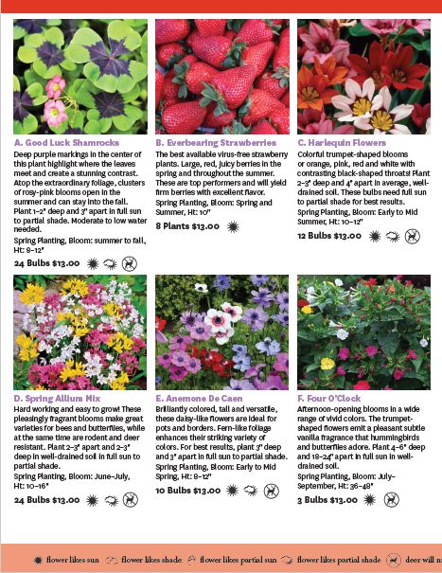
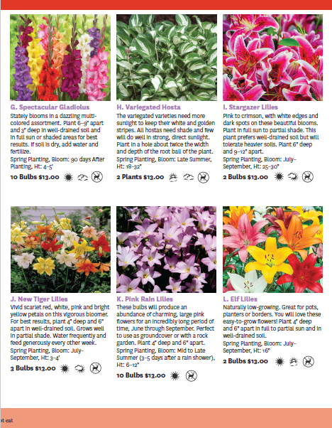
BROCHURE FOR SPRING 2023 – ALL PERENNIALS
INSIDE VIEW (2 pages of the 3 2023 spring sale product pages shown)

Slide 3
18 TYPES OF BULBS OFFERED all priced at $13 per package
Good Luck Shamrocks 24 bulbs
Everbearing Strawberries 8 bulbs
Harlequin Flowers 12 bulbs
Spring Allium Mix 24 bulbs
Anemone De Caen 10 bulbs
Four O’Clock Mix 3 bulbs
Spectacular Gladiolus Mix 10 bulbs
Variegated Hosta 2 bulbs
Stargazer Lilies 2 bulbs
Tiger Lilies 3 bulbs
Pink rain Lilies 10 bulbs
Elf Lilies 2 bulbs
Ranunculus Mix 8 bulbs
Lavender Astilbe 1 bulb
Blazing Stars 12 bulbs
Peacock Orchids 18 bulbs
Jaguar Flowers 12 bulbs
Bleeding Hearts 1 bulb

Slide 4
BROCHURE FUNDRAISING
Pick up brochures from the Council
Take orders and collect money, tear off the perforated order form to hand in to the unit spring sale champion/coordinator
Use provided order forms to submit order to the Council (forms will be also be available on the Council’s website to assist with this step)
Submit 75% of your unit’s total sales with payment – unit keeps commission of 25%
Dutch Mill Bulbs will ship all brochure orders to the Council for free
Pick-up your flower bulb order from Council offices
Sort and distribute to the members of your unit
Remind Scouts to thank their supporters when delivering their flower bulbs

Slide 5
ONLINE FUNDRAISING
Specific instructions to make sure the Scout in your Unit gets credit and the direct link/QR Code to the Council’s spring sale landing page on the Dutch Mill website will be provided in your sales kit
Online Sales will incur shipping costs beginning at $10. Example: 1-4 pkgs of bulbs….. $10.00, 5-9 pkgs of bulbs…... $12.00
For online sales, commissions will be credited to the unit’s store account once payment has been received from Dutch Mill AND the Unit and Scout associated with each sale has been confirmed (same process as Fall Sale)

Slide 6
Important Information and Planned Dates
Scouts/units earn 25% from product sales
All sales will be pre-order or online (no Show and Sell opportunities)
Now through – January 13 - Unit signup through Council’s Website: PADutchbsa.org under Spring Product Sale
https://www.emailmeform.com/builder/form/JcA2aH0myc55bDfw2C86tuz
January 5 – Kickoff presentation at your District Roundtable
Pick up flyers from Council Office starting January 13
Sale from January 23 – February 24 (online orders included)
All orders & money into council office no later than March 8th
Pickup and distribution of kits week of April 7 (to be confirmed)

Slide 7
Useful Information and Forms on PA Dutch Council Website
www.padutchbsa.org → Fundraising → Spring 2023 Product Sale

Slide 8
Resources Coming soon to Council Website
2023 Spring Product Sale Unit Guidebook
Spring 2023 Dutch Mill Bulbs Fundraising Brochure
2023 Unit Sales Tracking Spreadsheet by Scout & Order Submission Form – interactive spreadsheet
2023 Spring Sale Unit Order Submission Form & Receipt (pdf)
If you do not use the Excel spreadsheet above to generate your order submission form, you can print this form to submit your unit’s order. We will still need to know the total sales for each Scout.
2023 Parents’ Spring Sale information sheet – basic info – “stuff” your Scout forgot to tell you
District Kickoff – PowerPoint – for Units to share at a meeting or through an online meeting platform with their Scouts and Families

Slide 9
AFTER THE SALE
Sale, including online sales, from January 23rd to February 24th
All orders and money into council office no later than March 8th
Complete the Unit Order Submission Form and Receipt and return to Council
Units write a single check to the Council (units keep the 25% commission)
Pickup and distribution of bulb orders, week of April 6 (to be confirmed)
Units arrange to get Bulbs to scouts for distribution
Please reach out to Zena Korba, Spring Sale Advisor, at zena.korba@scouting.org, Desiree Nelson, Iron Forge District Sales Champion, at nelsondesiree8@gmail.com or Chet Bowen, Susquehanna District Sales Champion, at bowen17@hotmail.com.

Slide 10
TO SIGN-UP YOUR UNIT, SCAN THIS CODE:

