Slide 1
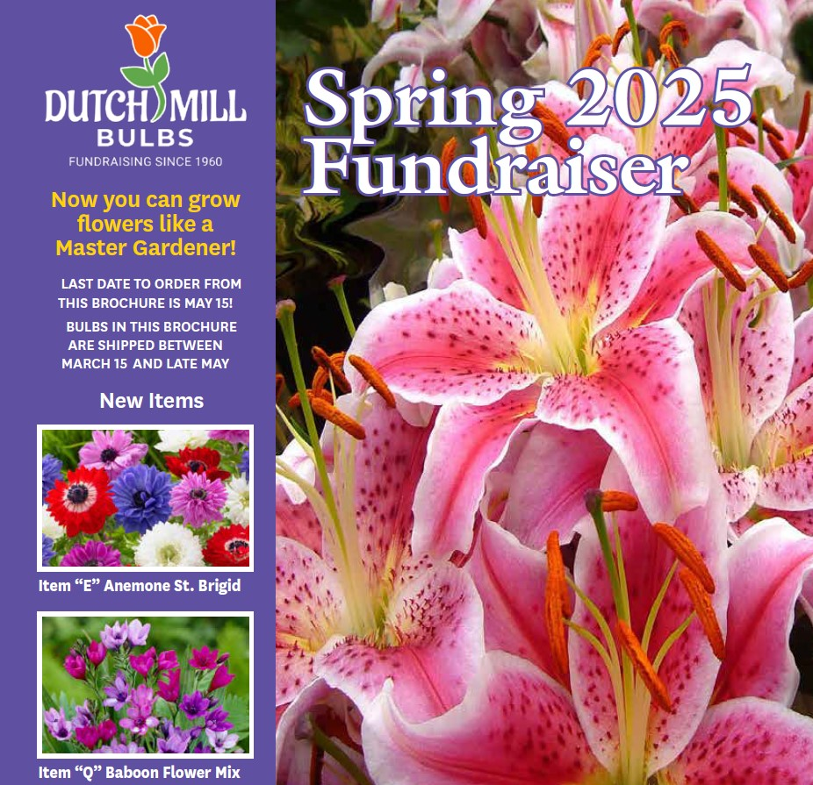
2025 PA Dutch Council Spring Product Sale Unit Summer Camp Fundraising Opportunity For Scouts
Sale Also Supports A Local Lebanon County Business
Within The Council’s Service Area
Notes:
The Spring Product Sale is designed to help Scouts earn their way to summer camp, day camp, a BSA high adventure base, or raise money for the unit’s outdoor program. This year, we have decided to sell summer flowering bulbs from Dutch Mill Bulbs as a “take order” only sale. Units participating in this program earn 25% commission from each product sold. The remainder of the funds will benefit the programs of the Pennsylvania Dutch Council, BSA.
Each bulb set is priced at $13 and there will be at least 18 types of bulb packages to choose from! These make great gifts for Mother’s Day, Father’s Day, housewarming, Easter, as well as gifts for clients.
The Spring Product sale will take place from February 28th to February 25th, 2023, allowing units about a month to earn money for their Scouting programs.

Slide 2
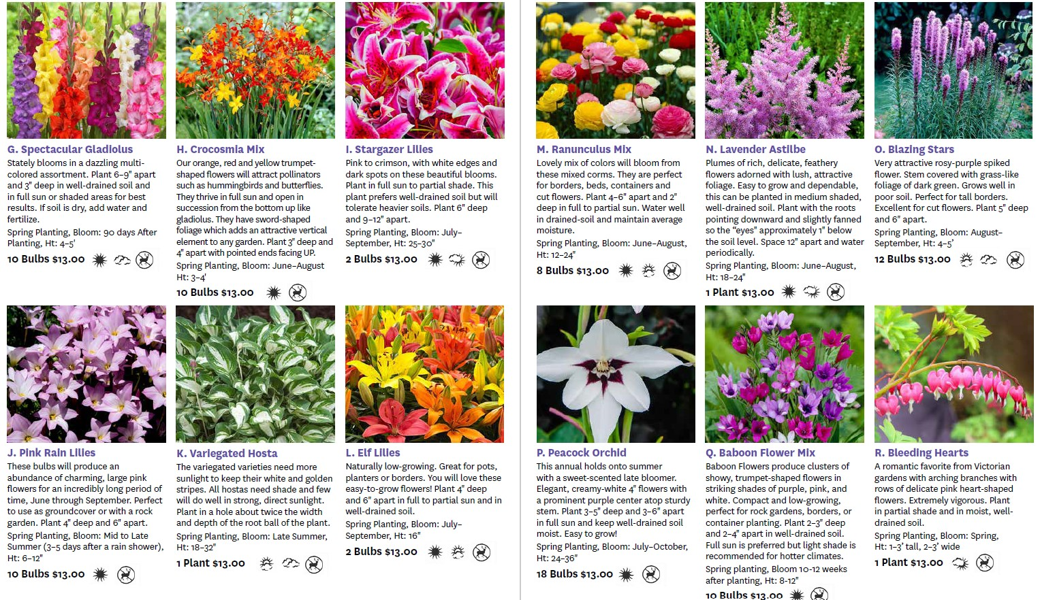
BROCHURE FOR SPRING 2025 – ALL PERENNIALS
INSIDE VIEW (2 pages of the 3 2025 spring sale product pages shown)

Slide 3
18 TYPES OF BULBS OFFERED all priced at $13 per package
Good Luck Shamrocks 24 bulbs
Everbearing Strawberries 8 bulbs
Harlequin Flowers 12 bulbs
Spring Allium Mix 24 bulbs
Anemone St. Brigid 10 bulbs
Four O’Clock Mix 3 bulbs
Spectacular Gladiolus Mix 10 bulbs
Crocosmia Mix 10 bulbs
Stargazer Lilies 2 bulbs
Pink Rain Lilies 10 bulbs
Variegated Hosta 1 plant
Elf Lilies 2 bulbs
Ranunculus Mix 8 bulbs
Lavender Astilbe 1 plant
Blazing Stars 12 bulbs
Peacock Orchid 18 bulbs
Baboon Flower Mix 10 bulbs
Bleeding Hearts 1 plant

Slide 4
BROCHURE FUNDRAISING
Pick up brochures from the Council
Take orders and collect money, tear off the perforated order form to hand in to the Unit Spring Sale Champion/Coordinator
Use provided order form to submit order to the Council (forms will be also be available on the Council’s website to assist with this step)
Submit 75% of your unit’s total sales with payment – unit keeps commission of 25%
Dutch Mill Bulbs will ship all brochure orders to the Council for free
Pick-up your flower bulb order from Council offices
Sort and distribute to the members of your Unit
Remind Scouts to thank their supporters when delivering their flower bulbs

Slide 5
ONLINE FUNDRAISING
Specific instructions to make sure the Scout in your Unit gets credit and the direct link/QR Code to the Council’s spring sale landing page on the Dutch Mill website will be provided in your sales kit
Online Sales will incur shipping costs beginning at $10. Example: 1-4 pkgs of bulbs….. $10.00, 5-9 pkgs of bulbs…... $12.00
For online sales, commissions will be credited to the unit’s store account once payment has been received from Dutch Mill AND the Unit and Scout associated with each sale has been confirmed (same process as Fall Sale)

Slide 6
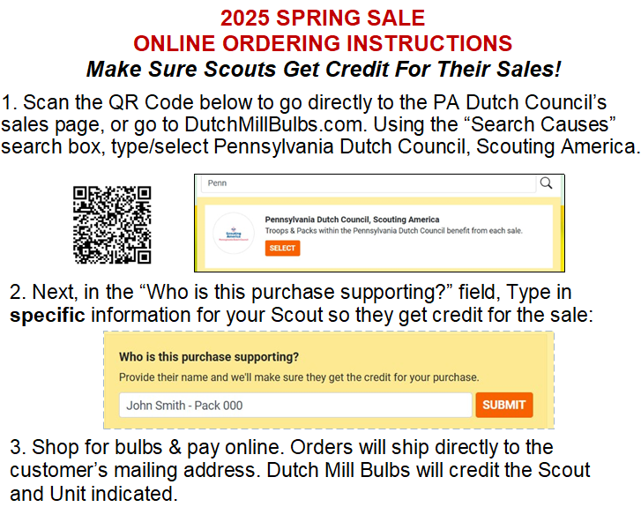
ONLINE SALES – CREDITING THE SCOUT

Slide 7
Important Information & Dates
Scouts/units earn 25% from product sales
All sales will be pre-order or online (no Show and Sell opportunities)
Now through – January 10 - Unit signup through Council’s Website: PADutchbsa.org under Spring 2025 Product Sale
https://www.emailmeform.com/builder/form/huyenfQF5x0886DqAmJY305
January 2 – Kickoff presentation at your District Roundtable
Pick up flyers from Council Office starting January 10 NOW!
January 14th – Info Session/Training for Unit Champions 7 pm via Zoom
Sale runs from January 17 – March 12 (including online sales)
All orders & money into council office no later than March 12th
Pickup and distribution of orders week of April 7

Slide 8
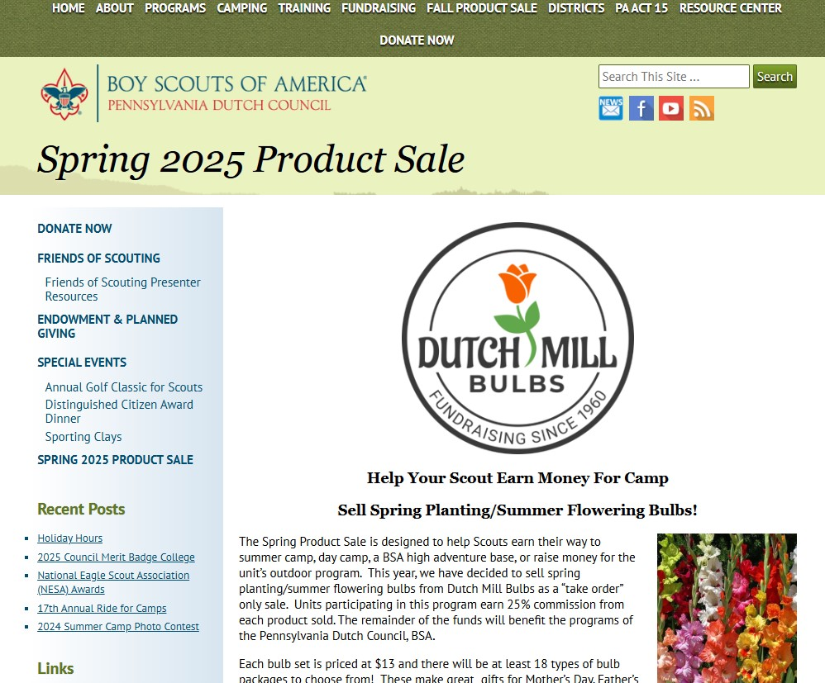
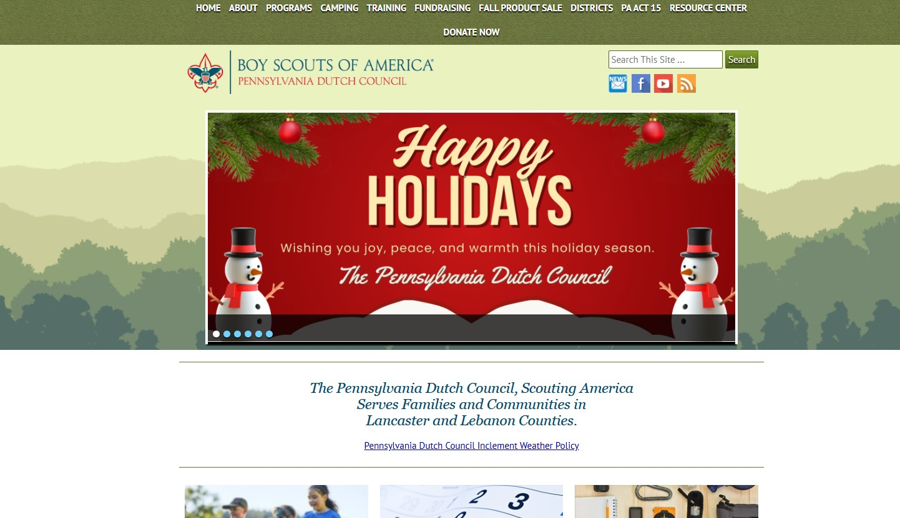
Useful Information and Forms on PA Dutch Council Website
www.padutchbsa.org → Fundraising → Spring 2025 Product Sale

Slide 9
Resources Coming Soon To The Council Website
2025 Spring Product Sale Unit Sign-Up/Registration Link
2025 Spring Product Sale - Overview for Parents (PDF) to email to each parent *
2025 Spring Sale Online Ordering Instructions Postcard For Scouts (PDF) **
2025 Unit Sales Commission Tracker By Scout and Order Submission Form (XLS) - automatically computes order, commission, and amount due to Council
2025 Unit Sales Commission Tracker by Scout and Order Submission Form (PDF) Manual entry version (you write in all info) *
If you do not use the auto-computing sales tracking spreadsheet above, these are the forms you would manually fill out and submit to the Council
2025 Dutch Mill Bulbs Spring Fundraiser Sales Brochure **
2025 Dutch Mill Product Listing and Bulb Specs** (climate zone, height, spacing, deer resistance, etc.)
*One copy included in Unit Sales Packet for Spring Sale Champion
**One copy included in Unit Sales Packet for each Scout in Unit

Slide 10
AFTER THE SALE
Sale, including online sales, from January 17th to March 12th
All orders and money into Council Office no later than March 12th
Complete the Unit Order Submission Form and Scout Sales Tracker and return to Council
Units write a single check to the Council (units keep the 25% commission)
Pickup and distribution of bulb orders, week of April 7th (to be confirmed)
Units arrange to get Bulbs to scouts for distribution
Please reach out to Zena Korba, Spring Sale Advisor, at zena.korba@scouting.org, Lauren Bowen, Spring Sale Administrator at lauren.bowen@scouting.org, Nicole Welch, Iron Forge District Executive, at Nicole.welch@scouting.org, or Chet Bowen, Susquehanna District Sales Champion, at bowen17@hotmail.com.

Slide 11
TO SIGN-UP YOUR UNIT, SCAN THIS CODE:

